Slide 1
phpMyAdmin?

Slide 2
What is phpMyAdmin?
phpMyAdmin is one of the most popular applications for MySQL database management. It is a free tool written in PHP. Through this software you can create, alter, drop, delete, import and export MySQL database tables. You can run MySQL queries, optimize, repair and check tables, change collation and execute other database management commands.

Slide 3
phpMyAdmin login page.
Enter Username and Password

Slide 4
phpMyAdmin Administration
Covers the following topics:
Databases
SQL
Status
Export
Import
Settings
Variables
Charsets
Engines
Plugins

Slide 5
Main Screen

Slide 6
In the panel on the left side of the page you will see the list of the databases for which your cPanel user has privileges.

Slide 7
How Can Create Database
You can create database in two ways.
1) Using Database Tab( GUI based)
2)Using Sql (Command based)

Slide 8
Click on Database tab and Create Database
Click on Database Tab

Slide 9
Enter Database Name and Click on Go
Click on Create
Enter Database Name

Slide 10
Click on Sql tab and Write a command for create database
Type Command Here
After Commend Click on Go
Type any Database Name
Keyword
Create Database Command : Create database databasename

Slide 11
Check your database in left side screen and Click on database
Enter Table Name
Enter Column Number
Click here
Click Go

Slide 12
Enter Column Names, its Type and Length/Values
Enter column name in text fields
Select data type for column value
Select Length
Click on Save

Slide 13
Select Data Type

Slide 14
Enter Length and Click on Save
Click on Save
Enter Length of Username and Password

Slide 15
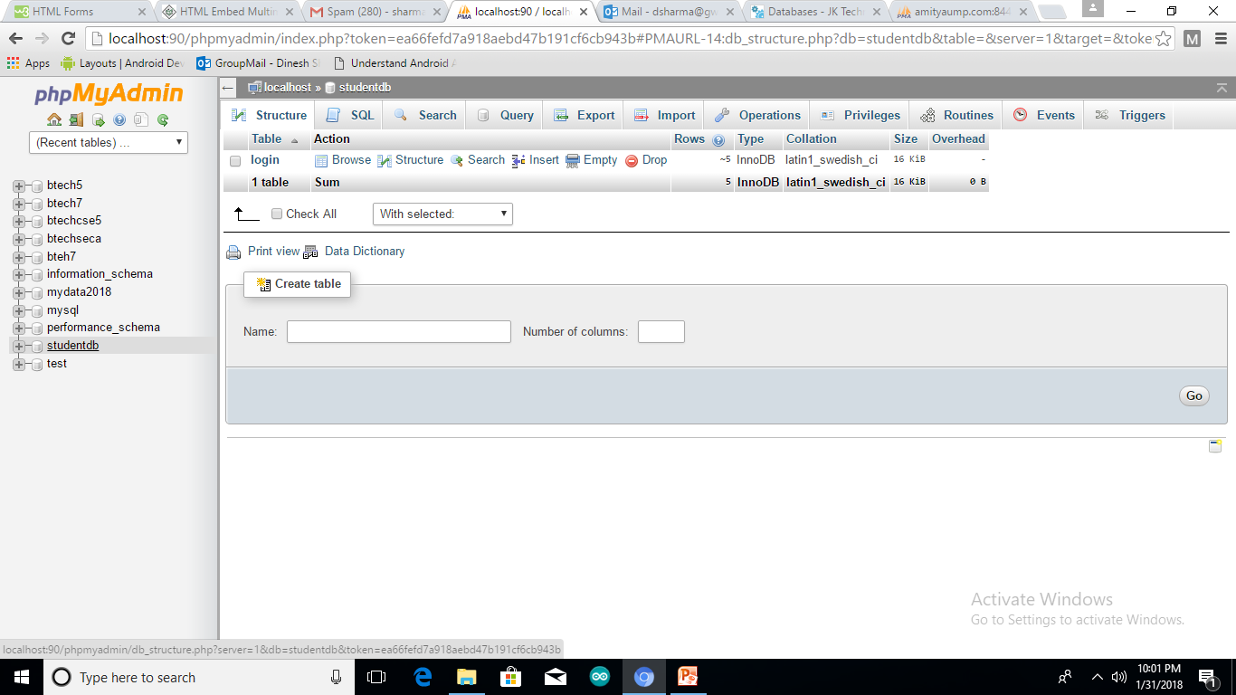
After this select database and Click on table
Click on table login
Select Database

Slide 16
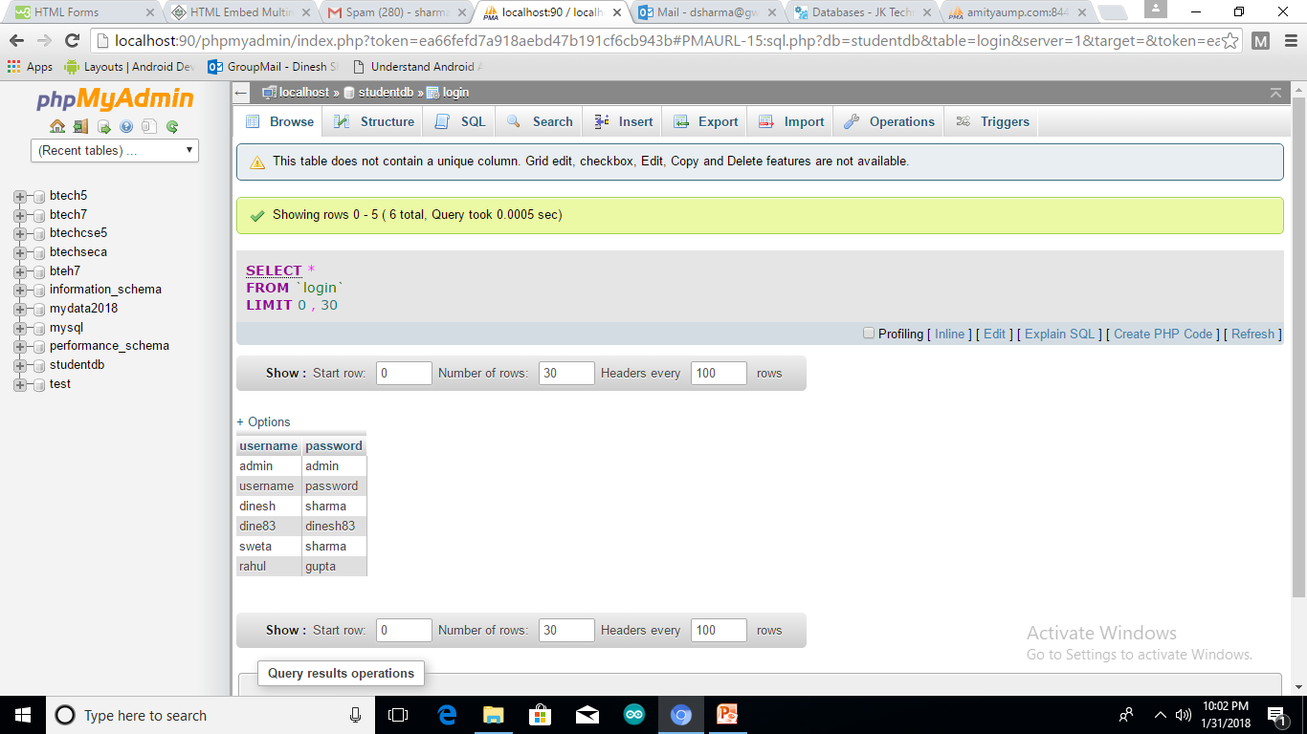
Now you can see your table data

Slide 17
Export Data from Table
Click on Export

Slide 18
Select format from dropdown list

Slide 19
Click on Go Button

Slide 20
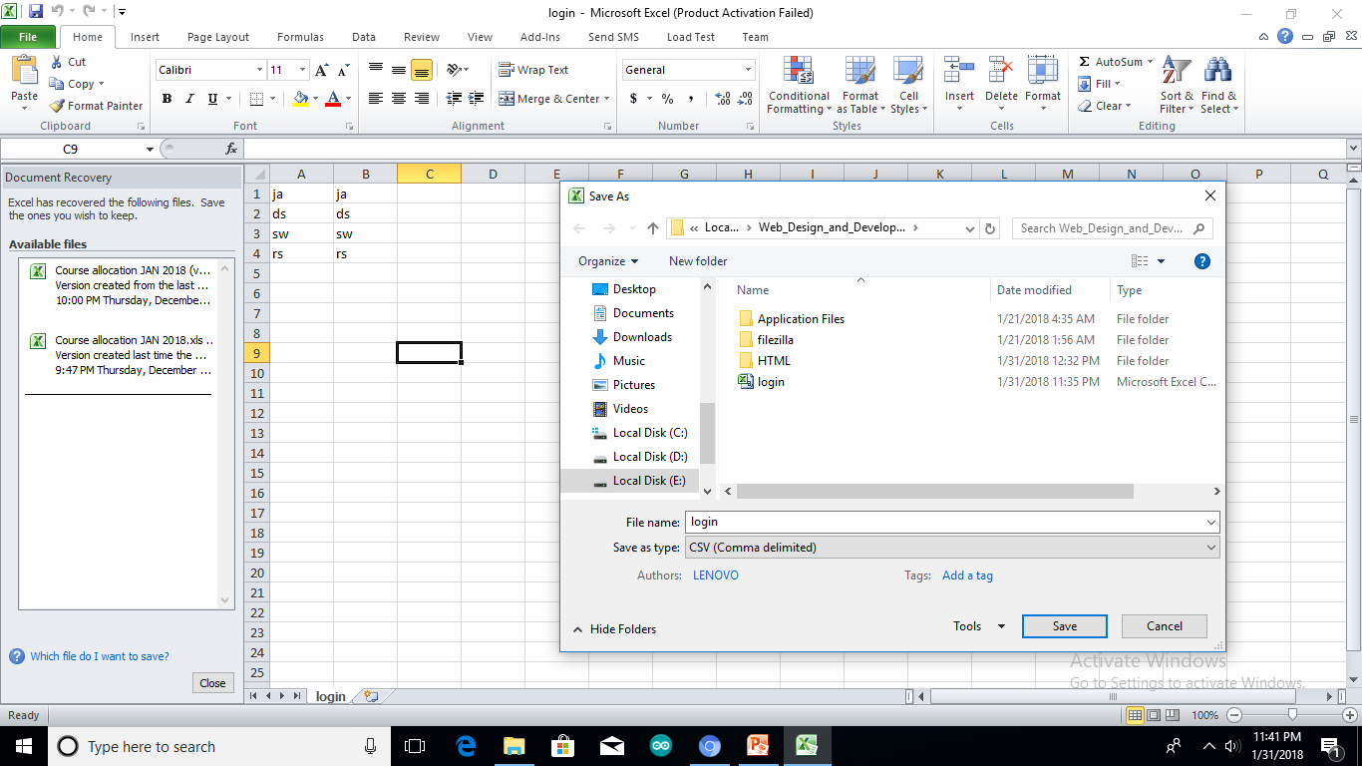
Import Data Excel to Table
First insert data in excel file and save it by .csv extension.

Slide 21
Now Click on database and open your table

Slide 22
Click on import and browse excel file

Slide 23
Cont..

Slide 24
Click on Go

