Slide 1
Multithreading

Slide 2
Agenda
Multiprocessing
Type of Multiprocessing
What is Thread
Type of Thread
Multithreading
Thread Life Cycle
Multithreading Example
Advantages of Multithreading

Slide 3
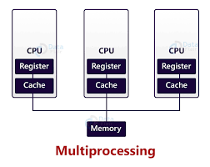
What is Multiprocessing
The process of using the entire CPU of the computer and being capable to execute more then two processes or computational jobs at a time is defined as multiprocessing.

Slide 4
Type of Multiprocessing
There are two type of Multiprocessing in java.
1) Process-Based Multiprocessing
2) Thread Based Multiprocessing
Multiprocessing
Process Based
Thread Based

Slide 6
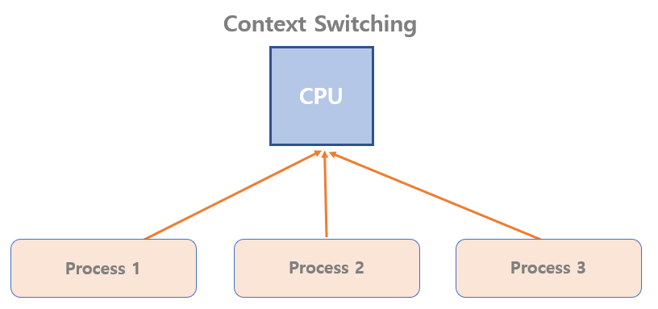
What is Thread(Separate flow of Execution)
A thread is an individual, light weight, and a smallest unit of a given process. There are multiple thread in a single process and each thread is independent of the other.
As shown in figure ,a thread is executed inside the process .There is a context switching
between the threads. There can be multiple processes inside the OS and one process
can have multiple threads.

Slide 7
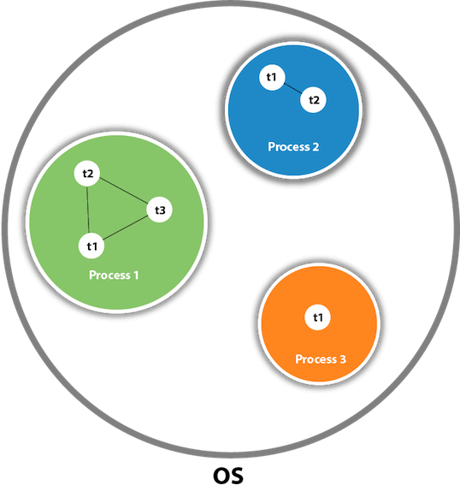

Slide 8
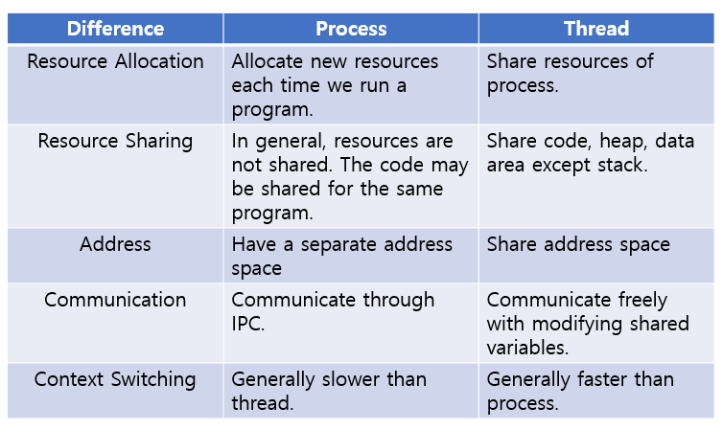

Slide 9
Type of Thread
1. User Thread
2. Daemon Thread
User threads are high-priority threads. The JVM will wait for any user thread to complete its task before terminating it. On the other hand, daemon threads are low-priority threads whose only role is to provide services to user threads

Slide 10
Use of Daemon Thread
Daemon threads are useful for background supporting tasks such as garbage collection, releasing memory of unused objects and removing unwanted entries from the cache. Most of the JVM threads are daemon threads.

Slide 12
Multithreading
Multithreading is a Java feature that allows concurrent execution of two or more parts of a program for maximum utilization of CPU. Each part of such program is called a thread. So, threads are light-weight processes within a process.
Threads can be created by using two mechanisms :
Extending the Thread class
Implementing the Runnable Interface

Slide 13
Cont..

Slide 14
Advantages of multithread
The users are not blocked because threads are independent, and we can perform multiple operations at times
As such the threads are independent, the other threads won’t get affected if one thread meets an exception.

Slide 15
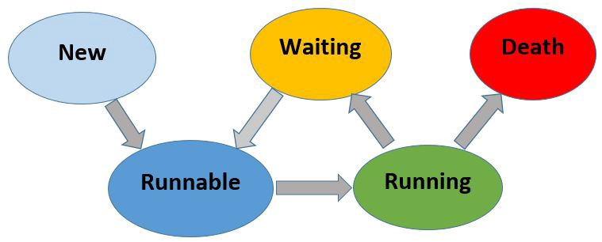
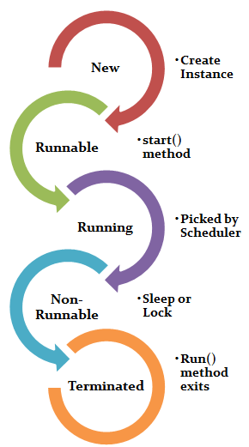
Thread Life Cycle in Java

Slide 16
New state
Before calling the start() method on the newly created thread instance, the thread is in a “new state”.
In this phase, the thread is created using class “Thread class”. It remains in this state till the program starts the thread. It is also known as born thread.

Slide 17
Runnable state
The thread is in a “runnable state” after calling the start() method, but it has not been selected as the running thread by the thread scheduler.
In this phase, the instance of the thread is invoked with a start method. The thread control is given to scheduler to finish the execution. It depends on the scheduler, whether to run the thread.

Slide 18
Running state
If the thread scheduler has selected it as a running thread, it is on the “running state”. A thread will only execute its task when it is on the “running state”.

Slide 19
Waiting state
When a thread is still alive but not eligible to run, then the thread is in the “waiting state”. A thread can move from “running state” to “waiting state” by certain conditions ex: sleep(), wait(). Same as that a thread can move from “waiting state” to “runnable state” by certain conditions ex: notify(), interrupt().

Slide 20
Death state or Terminate
When a thread completes all of the tasks assigned to it, or when its run() method exits, it will become a dead thread.

Slide 21
Example
package demotest;
public class GuruThread {
public static void main(String[] args)
{
System.out.println("Single Thread");
}
}

Slide 22
Creating Threads
We can create threads in two different ways, They are
Extend Thread class
Implement Runnable interface
The behaviour of the thread object will be the same in both ways.

Slide 23
Method 1-Extend thread class
public class Mythread extends Thread{
@Override
public void run(){
System.out.println("Hi!! This is from child thread");
}
}public class Application {
public static void main(String[] args) {
Mythread mythread=new Mythread();
mythread.start();
}}

Slide 24
What is start() method and run() method?
We override the run() method and specify the tasks we want to assign to the newly created thread. Then we call the start() method on the thread instance that we created. Please keep in mind that the start() method is belongs to “Thread” class, and it will call the run() method internally.

Slide 25
What happens if we didn’t override the run() Method?
A thread will be created, but it does nothing and then it will go to death state.
public class Mythread extends Thread{
//we didn't override run() method here }
public class Application {
public static void main(String[] args) {
Mythread mythread=new Mythread();
mythread.start();
}
}

Slide 26
Explanation
When we invoke the start() method, A thread will be created. start() method will invoke the run() method internally. Then JVM checks whether the child class contains a run() method. If yes then child class’s run method will be executed. If not JVM will execute the parent (Thread) class’s run() method. In Java “Thread” class’s run() method doesn’t contain any tasks in its body. Therefore if we didn’t override the run() method, the Thread class’s run() method will be invoked and it does nothing.

Slide 27
Can we overload the run() method?
public class Mythread extends Thread{
@Override
public void run(){
System.out.println("Hi!! This is from child thread default run method");
}
public void run(String name){
System.out.println("Hi!! This is from child thread's over loaded method");
}
}
public class Application {
public static void main(String[] args) {
Mythread mythread=new Mythread();
mythread.start();
}}

Slide 28
Explanation
Yes we can overload the run() method. but start() method will only invoke run() method which has no arguments. Therefore the overloaded run() method will not be invoked by start() method.

Slide 29
Can we invoke run() method instead of start() method?
public class Mythread extends Thread{
@Override
public void run(){
System.out.println(“This method is executed by:“
+Thread.currentThread.getName());
}
}
public class Application {
public static void main(String[] args) {
Mythread mythread=new Mythread();
//mythread.start();
Mythread.run();
}
}

Slide 30
Explanation
We can invoke the run() method directly. but it will not create a new child thread. Instead, parent thread will execute the child thread object’s run() method. This will be a typical OOP method invoking.

Slide 31
Can we override the start() method?
public class Mythread extends Thread{
@Override
public void run(){
System.out.println(“This is run method”);
}
@Override
public void start(){
System.out.println(“This is start method”);
}
}
public class Application {
public static void main(String[] args) {
Mythread mythread=new Mythread();
mythread.start();
}
}

Slide 32
Drawbacks of this way of Thread Creation
We know Java doesn’t support multiple inheritances. In this way, Since user-created class (Mythread) Inherits the characteristics from “Thread class”, user-created class (Mythread)can’t inherit another class.

Slide 33
Method 2: Implement the Runnable Interface
To create a thread by runnable interface we must create a class that implements runnable interface.
public class Rnblthread implements Runnable{
@Override
public void run() {
System.out.println("Hi!! This is from a child thread which is created
by runnable interface");
}
}

Slide 34
Cont..
After implementing the runnable interface we can simply create the thread by creating a thread object.
public class Application {
public static void main(String[] args) {
Runnable r=new Rnblthread();
Thread mythread= new Thread(r);
mythread.start();
}
}

Slide 35
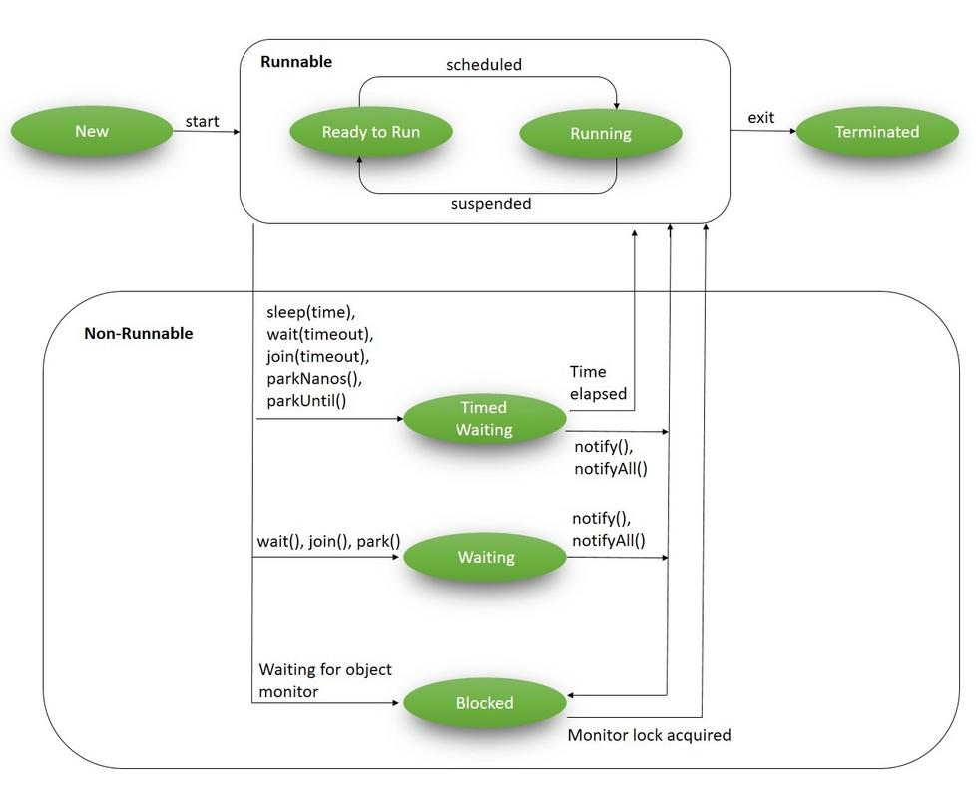

Slide 36
Cont..
NEW – a newly created thread that has not yet started the execution
RUNNABLE – either running or ready for execution but it's waiting for resource allocation
BLOCKED – waiting to acquire a monitor lock to enter or re-enter a synchronized block/method
WAITING – waiting for some other thread to perform a particular action without any time limit
TIMED_WAITING – waiting for some other thread to perform a specific action for a specified

Slide 37
New
Runnable runnable = new NewState();
Thread t = new Thread(runnable); Log.info(t.getState());

Slide 38
Runnable
When we've created a new thread and called the start() method on that, it's moved from NEW to RUNNABLE state. Threads in this state are either running or ready to run, but they're waiting for resource allocation from the system
In a multi-threaded environment, the Thread-Scheduler (which is part of JVM) allocates a fixed amount of time to each thread. So it runs for a particular amount of time, then relinquishes the control to other RUNNABLE threads.

Slide 39
Example
Runnable runnable = new NewState();
Thread t = new Thread(runnable);
t.start();
Log.info(t.getState());

Slide 40
Blocked
A thread is in the BLOCKED state when it's currently not eligible to run. It enters this state when it is waiting for a monitor lock and is trying to access a section of code that is locked by some other thread.

Slide 41
Example
import java.util.logging.LogManager;
Impoort java.util.logging.Logger;
public class BlockedState {
public static void main(String[] args) throws InterruptedException {
Thread t1 = new Thread(new DemoThreadB());
Thread t2 = new Thread(new DemoThreadB());
LogManager lgmngr=LogManager.getLogManager();
Logger log=lgmngr.getLogger(Logger.GLOBAL_LOGGER_NAME);
t1.start();
t2.start();
Thread.sleep(1000);
log.info(String.valueOf(t2.getState()));
System.exit(0); }
}

Slide 42
Example
class DemoThreadB implements Runnable { @Override
public void run() {
commonResource();
}
public static synchronized void commonResource() {
while(true) { // Infinite loop to mimic heavy processing // 't1' won't leave this method // when 't2' try to enter this } } }

Slide 43
Explanation
We've created two different threads – t1 and t2
t1 starts and enters the synchronized commonResource() method; this means that only one thread can access it; all other subsequent threads that try to access this method will be blocked from the further execution until the current one will finish the processing
When t1 enters this method, it is kept in an infinite while loop; this is just to imitate heavy processing so that all other threads cannot enter this method
Now when we start t2, it tries to enter the commonResource() method, which is already being accessed by t1, thus, t2 will be kept in the BLOCKED state

Slide 44
List of Commonly Used Thread class Constructors.
Thread class has the following eight constructors.
Thread(): It creates a Thread object with a default name.
Thread(String name): It creates a Thread object with a name that the name argument specifies.
Thread (Runnable r): This method constructs Thread with a parameter of the Runnable object that defines the run() method.
Thread (Runnable r, String name): This method creates Thread with a name and a Runnable object parameter to set the run() method.
Thread(ThreadGroup group, Runnable target): It creates a Thread object with a Runnable object and the group to which it belongs.

Slide 45
Thread (ThreadGroup group, Runnable target, String name): It creates Thread object with a Runnable object that defines the run() method, specified name as its name and the Thread object belongs to the ThreadGroup referred to by the group.
Thread(ThreadGroup group, String name): It creates a thread that has the specified name and associates to the ThreadGroup given as the first parameter.
Thread(ThreadGroup group, Runnable target, String name, long stackSize): this constructor specifies the ThreadGroup parameter, the size of the thread’s method-call stack.

Slide 46
Commonly used methods of Thread class
public void run(): is used to perform action for a thread.
public void start(): starts the execution of the thread.JVM calls the run() method on the thread.
public void sleep(long miliseconds): Causes the currently executing thread to sleep (temporarily cease execution) for the specified number of milliseconds.
public void join(): waits for a thread to die.
public void join(long miliseconds): waits for a thread to die for the specified miliseconds.
public int getPriority(): returns the priority of the thread.
public int setPriority(int priority): changes the priority of the thread.
public String getName(): returns the name of the thread.

Slide 47
9. public void setName(String name): changes the name of the thread.
10. public Thread currentThread(): returns the reference of currently executing thread.
11. public int getId(): returns the id of the thread.
12. public Thread.State getState(): returns the state of the thread.
13. public boolean isAlive(): tests if the thread is alive.
14. public void yield(): causes the currently executing thread object to temporarily pause and allow other threads to execute.
15. public void suspend(): is used to suspend the thread(depricated).
16. public void resume(): is used to resume the suspended thread(depricated).
17. public void stop(): is used to stop the thread(depricated)

Slide 48
18. public boolean isDaemon(): tests if the thread is a daemon thread.
19. public void setDaemon(boolean b): marks the thread as daemon or user thread.
20. public void interrupt(): interrupts the thread.
21. public boolean isInterrupted(): tests if the thread has been interrupted.
22. public static boolean interrupted(): tests if the current thread has been interrupted.

Slide 49
Thread Example by implementing Runnable interface
class Multi3 implements Runnable{
public void run(){
System.out.println("thread is running...");
}
public static void main(String args[]){
Multi3 m1=new Multi3();
Thread t1 =new Thread(m1); // Using the constructor Thread(Runnable r)
t1.start();
}
}

Slide 50
Example getName()
public class MyThread1
{
// Main method
public static void main(String argvs[])
{
// creating an object of the Thread class using the constructor Thread(String name)
Thread t= new Thread("My first thread");
// the start() method moves the thread to the active state
t.start();
// getting the thread name by invoking the getName() method
String str = t.getName();
System.out.println(str);
}
}

Slide 51
Using the Thread Class: Thread(Runnable r, String name)
public class MyThread2 implements Runnable {
public void run()
{
System.out.println("Now the thread is running ...");
}
public static void main(String argvs[]) {
// creating an object of the class MyThread2
Runnable r1 = new MyThread2();
// creating an object of the class Thread using Thread(Runnable r, String name)
Thread th1 = new Thread(r1, "My new thread");
// the start() method moves the thread to the active state
th1.start();
// getting the thread name by invoking the getName() method
String str = th1.getName();
System.out.println(str);
} }

Slide 52
Example
class MyThread extends Thread {
MyThread () {
// The compiler creates the byte code equivalent of super ();
}
MyThread (String name) {
setName (name);
// Pass name to Thread superclass
}
public void run () {
System.out.println ("My name is: " + getName ());
}
}
class NameMyThread
{
public static void main (String [] args)
{
MyThread mt;
if (args.length == 0)
mt = new MyThread ();
else mt = new MyThread (args [0]);
mt.start ();
}
}

Slide 53
Sleep (long milliseconds)
It suspends a thread for the specified period. If any other thread interrupts this sleeping thread, it will throw an InterruptedException. So it is suggested to enclose the sleep() method in the try block. Alternatively, the code’s method must include InterruptedException in its throws clause.

Slide 54
boolean isAlive()
It determines if a thread is still running. JVM considers a thread to be alive immediately before calling to thread’s run() method, during the execution of thread’s run() and immediately after return from run().
During that interval, the isAlive() method returns a “true” Boolean value. Otherwise, it returns false.
This method is useful in the situations when one thread needs to wait for another thread to finish its run() method.

Slide 55
class ThreadSleepDemo{
public static void main(String args[]){
MyThread obj=new MyThread();
obj.start();
while(obj.isAlive())
{
try {
obj.sleep(10);
} catch(InterruptedException e) {
System.out.println(“Sleeping thread interrupted”);
}
System.out.println(“Thread-Sleep Demo Complete”);
}
}
}
class MyThread extends Thread{
public void run(){
System.out.println("My thread is in running
state.");
}
}

Slide 56
join(long milliseconds)
This method gets called when a thread wants to wait for another thread to terminate. Let’s see a sample code for the <join()> method.
class MyThread extends Thread{
public void run(){
System.out.println("My thread is in running
state.");
}
}
class ThreadJoinDemo{
public static void main(String args[]){
MyThread obj=new MyThread();
obj.start();
try {
obj.join();
}
catch(InterruptedException e) {
}
System.out.println(“Thread-Join Demo Complete”);
}
}
}

Slide 57
Thread currentThread():
It returns the instance reference of the currently executing thread.
Thread.State getState():
It returns the state of the thread.

Slide 58
class ThreadStateTest {
public static void main (String [] args) {
Thread currentThread = Thread.currentThread();
System.out.println(currentThread);
MyThread mt1 = new MyThread ();
mt1.setName("MyThread1");
MyThread mt2 = new MyThread();
mt1.setName("MyThread2");
System.out.println("Thread State of MyThread1 before calling start: "+mt1.getState());
mt1.start ();
mt2.start();
System.out.println("Thread State of MyThread1 in Main method before Sleep: " + mt1.getState());
System.out.println("Thread State of MyThread2 in Main method before Sleep: " + mt2.getState());
try {
Thread.sleep (1000);
} catch (InterruptedException e) {
}
System.out.println("Thread State of MyThread1 in Main method after Sleep: " + mt1.getState());
System.out.println("Thread State of MyThread2 in Main method after Sleep: " + mt2.getState());
}
}

Slide 59
class MyThread extends Thread {
public void run () {
System.out.println ("Run by " + Thread.currentThread().getName ());
try {
Thread.sleep (100);
} catch (InterruptedException e) {
}
System.out.println("Thread State of: "+ Thread.currentThread().getName()+ " -
"+Thread.currentThread().getState());
System.out.println("Exit of Thread: " + Thread.currentThread().getName());
}
}

Slide 60
yield()
This method causes the currently executing thread object to pause temporarily and allow other threads to run.
public class ThreadTest extends Thread {
public void run() {
System.out.println("In run");
yield();
System.out.println("Leaving run");
}
public static void main(String []argv) {
(new ThreadTest()).start();
}
}

Slide 61
final int getPriority() & final void setPriority(int priority)
It returns the priority of the thread.
This function is used to change the priority of a thread.
public class ThreadDemo {
public static void main(String[] args) {
Thread t = Thread.currentThread();
t.setName("Admin Thread"); // set thread priority to 1
t.setPriority(1); // prints the current thread
System.out.println("Thread = " + t); int priority= t.getPriority();
System.out.println("Thread priority= " + priority);
int count = Thread.activeCount();
System.out.println("currently active threads = " + count);
}
}

Slide 62
Cont..
int getId():
It returns the id of the thread.
interrupt():
It interrupts the thread.
boolean isInterrupted():
tests if the thread has been interrupted and returns the interrupted flag either true or false.
boolean interrupted():
The static interrupted() method tests if the thread has been interrupted. This method returns the interrupted flag after that it sets the flag to false if it is true.

Slide 63
public class TestThreadInterrupt extends Thread {
public void run() {
for (int i = 1; i <= 2; i++) {
if (Thread.interrupted()) {
System.out.println("code for interrupted thread");
} else {
System.out.println("code for normal thread");
}
}
//end of for loop
}
public static void main(String args[]) {
TestThreadInterrupt t1 = new TestThreadInterrupt();
TestThreadInterrupt t2 = new TestThreadInterrupt();
t1.start();
t1.interrupt();
t2.start();
}
}

Slide 64
Cont..
suspend():
You can use it to suspend the thread. [deprecated]
resume():
You can use it to resume the suspended thread. [deprecated]
stop():
You can use it to halt the thread.

Slide 65
Thread Priority
Each thread has a priority. Priorities are represented by a number between 1 and 10. In most cases, the thread scheduler schedules the threads according to their priority (known as preemptive scheduling). But it is not guaranteed because it depends on JVM specification that which scheduling it chooses. Note that not only JVM a Java programmer can also assign the priorities of a thread explicitly in a Java program.

Slide 66
Setter & Getter Method of Thread Priority
public final int getPriority(): The java.lang.Thread.getPriority() method returns the priority of the given thread.
public final void setPriority(int newPriority): The java.lang.Thread.setPriority() method updates or assign the priority of the thread to newPriority. The method throws IllegalArgumentException if the value newPriority goes out of the range, which is 1 (minimum) to 10 (maximum).

Slide 67
Constants Defined in Thread Class
public static int MIN_PRIORITY
public static int NORM_PRIORITY
public static int MAX_PRIORITY
Default priority of a thread is 5 (NORM_PRIORITY). The value of MIN_PRIORITY is 1 and the value of MAX_PRIORITY is 10.

Slide 68
Example
import java.lang.*;
public class ThreadPriorityExample extends Thread {
public void run() {
System.out.println("Inside the run() method");
}
public static void main(String argvs[])
{
ThreadPriorityExample th1 = new ThreadPriorityExample();
ThreadPriorityExample th2 = new ThreadPriorityExample();
ThreadPriorityExample th3 = new ThreadPriorityExample();
}

Slide 69
System.out.println("Priority of the thread th1 is : " + th1.getPriority());
System.out.println("Priority of the thread th2 is : " + th2.getPriority());
System.out.println("Priority of the thread th2 is : " + th2.getPriority());
th1.setPriority(6);
th2.setPriority(3);
th3.setPriority(9);
System.out.println("Priority of the thread th1 is : " + th1.getPriority());
System.out.println("Priority of the thread th2 is : " + th2.getPriority());

Slide 70
System.out.println("Priority of the thread th3 is : " + th3.getPriority());
System.out.println("Currently Executing The Thread : " + Thread.currentThread().getName());
System.out.println("Priority of the main thread is : " + Thread.currentThread().getPriority());
Thread.currentThread().setPriority(10);
System.out.println("Priority of the main thread is : " + Thread.currentThread().getPriority());
}
}

Slide 71
Synchronization
Synchronization in Java is the capability to control the access of multiple threads to any shared resource.
Java Synchronization is better option where we want to allow only one thread to access the shared resource.

Slide 72
Why use Synchronization?
The synchronization is mainly used to
To prevent thread interference.
To prevent consistency problem.

Slide 73
Types of Synchronization
There are two types of synchronization.
Process Synchronization
Thread Synchronization

Slide 74
Thread Synchronization
There are two types of thread synchronization mutual exclusive and inter-thread communication.
Mutual Exclusive
Synchronized method.
Synchronized block.
Static synchronization.
Cooperation (Inter-thread communication in java)

Slide 75
Mutual Exclusive
Mutual Exclusive helps keep threads from interfering with one another while sharing data. It can be achieved by using the following three ways:
By Using Synchronized Method
By Using Synchronized Block
By Using Static Synchronization

Slide 76
Concept of Lock in Java
Synchronization is built around an internal entity known as the lock or monitor. Every object has a lock associated with it. By convention, a thread that needs consistent access to an object's fields has to acquire the object's lock before accessing them, and then release the lock when it's done with them.

Slide 77
Example Without Synchronization
class Table{
void printTable(int n){
//method not synchronized
for(int i=1;i<=5;i++){
System.out.println(n*i);
try{
Thread.sleep(400);
}catch(Exception e){System.out.println(e);}
}
}
}

Slide 78
class MyThread1 extends Thread{
Table t;
MyThread1(Table t){
this.t=t;
}
public void run(){
t.printTable(5);
}
}

Slide 79
class MyThread2 extends Thread{
Table t;
MyThread2(Table t){
this.t=t;
}
public void run(){
t.printTable(100);
}
}

Slide 80
class TestSynchronization1{
public static void main(String args[]){
Table obj = new Table();//only one object
MyThread1 t1=new MyThread1(obj);
MyThread2 t2=new MyThread2(obj);
t1.start();
t2.start();
}
}

Slide 81
Output : 5
100
10
200
15
300
20
400
15
500

Slide 82
Synchronized Method
If you declare any method as synchronized, it is known as synchronized method.
Synchronized method is used to lock an object for any shared resource.
When a thread invokes a synchronized method, it automatically acquires the lock for that object and releases it when the thread completes its task.

Slide 83
Example With Synchronization
class Table{
Synchronized void printTable(int n){
//method not synchronized
for(int i=1;i<=5;i++){
System.out.println(n*i);
try{
Thread.sleep(400);
}catch(Exception e){System.out.println(e);}
}
}
}

Slide 84
class MyThread1 extends Thread{
Table t;
MyThread1(Table t){
this.t=t;
}
public void run(){
t.printTable(5);
}
}

Slide 85
class MyThread2 extends Thread{
Table t;
MyThread2(Table t){
this.t=t;
}
public void run(){
t.printTable(100);
}
}

Slide 86
class TestSynchronization1{
public static void main(String args[]){
Table obj = new Table();//only one object
MyThread1 t1=new MyThread1(obj);
MyThread2 t2=new MyThread2(obj);
t1.start();
t2.start();
}
}

Slide 87
Output : 5
10
15
20
25
100
200
300
400
500

Slide 88
Synchronized method by using annonymous class
class Table{
Synchronized void printTable(int n){
//method not synchronized
for(int i=1;i<=5;i++){
System.out.println(n*i);
try{
Thread.sleep(400);
}catch(Exception e){System.out.println(e);}
}
}
}

Slide 89
public class TestSynchronization3{
public static void main(String args[]){
final Table obj = new Table();
//only one object
Thread t1=new Thread(){
public void run(){
obj.printTable(5);
}
};

Slide 90
Thread t2=new Thread(){
public void run(){
obj.printTable(100);
}
};
t1.start();
t2.start();
}
}

Slide 91
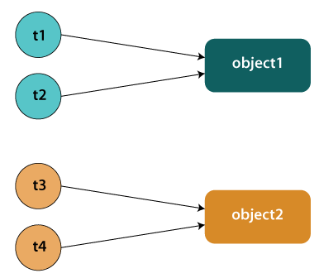
Static Synchronization
If you make any static method as synchronized, the lock will be on the class not on object.

Slide 92
Problem without static synchronization
Suppose there are two objects of a shared class (e.g. Table) named object1 and object2. In case of synchronized method and synchronized block there cannot be interference between t1 and t2 or t3 and t4 because t1 and t2 both refers to a common object that have a single lock. But there can be interference between t1 and t3 or t2 and t4 because t1 acquires another lock and t3 acquires another lock. We don't want interference between t1 and t3 or t2 and t4. Static synchronization solves this problem.

Slide 93
Example
class Table {
synchronized static void printTable(int n){
for(int i=1;i<=10;i++){
System.out.println(n*i);
try{
Thread.sleep(400);
} catch(Exception e){}
}
} }

Slide 94
class MyThread1 extends Thread{
public void run(){
Table.printTable(1);
}
}
class MyThread2 extends Thread{
public void run(){
Table.printTable(10);
}
}

Slide 95
class MyThread1 extends Thread{
public void run(){
Table.printTable(100);
}
}
class MyThread2 extends Thread{
public void run(){
Table.printTable(1000);
}
}

Slide 96
public class TestSynchronization4{
public static void main(String t[]){
MyThread1 t1=new MyThread1();
MyThread2 t2=new MyThread2();
MyThread3 t3=new MyThread3();
MyThread4 t4=new MyThread4();
t1.start();
t2.start();
t3.start();
t4.start();
}
}

