Slide 1
Module-1:
Introduction to Reinforcement Learning What is RL?, RL algorithm, How RL differs from other ML paradigms Elements of RL: Agent, Policy function,Value function,Model Agent environment interface, Types of RL environment, Deterministic environment Stochastic environment, Fully observable environment, Partially observable environment Discrete environment, Continuous environment, Episodic and non-episodic environment, Single and multi-agent environment, RL platforms, OpenAI Gym and Universe, DeepMind Lab, RL-Glue, Project Malmo, ViZDoom, Applications of RL, Education, Medicine and healthcare, Manufacturing, Inventory management, Finance Natural Language Processing and Computer Vision
By
Dr. Ashok Kumar

Slide 2
Introduction
What is Artificial Intelligence (AI)?
Artificial Intelligence (AI) is a branch of computer science that focuses on creating machines or software that can simulate human intelligence.
Definition of AI:
Artificial Intelligence is the ability of a machine or computer program to perform tasks that typically require human intelligence, such as learning, reasoning, problem-solving, understanding language, and perception.
Key Features of AI:
Learning: Acquiring knowledge and skills through experience (e.g., machine learning)
Reasoning: Making decisions based on rules and logic
Problem Solving: Finding solutions to complex issues
Perception: Interpreting inputs like vision, sound, and text
Language Understanding: Communicating in natural languages (e.g., English

Slide 3
Introduction
What is Machine Learning (ML)?
Machine Learning is a subset of Artificial Intelligence (AI) that enables computers to learn from data and make decisions or predictions without being explicitly programmed.
Definition of Machine Learning:
Machine Learning is the field of study that gives computers the ability to learn from experience (data) and improve performance on a specific task.
Key Idea:
Instead of writing specific rules for every task, we give the machine examples (data), and it learns the patterns or relationships from that data to make predictions or decisions.

Slide 4
Introduction
Types of Machine Learning:
Type | Description | Example
Supervised Learning | Learn from labeled data (input + output) | Spam detection, fraud detection
Unsupervised Learning | Find patterns in unlabeled data | Customer segmentation, clustering
Reinforcement Learning | Learn by trial and error to maximize reward | Game-playing AI, robotics

Slide 5
Introduction to Reinforcement Learning
What is Reinforcement Learning (RL)?
Reinforcement Learning is a type of Machine Learning.
It enables an agent to learn optimal behaviors through interactions with an environment.
The goal is to maximize cumulative reward over time.

Slide 6
Key Terminologies in Reinforcement Learning
Introduction to Reinforcement Learning
Term | Description
Agent | The learner or decision-maker that interacts with the environment.
Environment | The external system the agent interacts with and tries to influence.
State (S) | A representation of the current situation the agent is in.
Action (A) | The set of all possible moves the agent can take from a given state.
Reward (R) | A scalar feedback signal received after taking an action; indicates good/bad.
Policy (π) | The strategy used by the agent to choose actions given a state.
Value Function (V) | The expected long-term return starting from a state under a policy.

Slide 7
Value Function
The value function in reinforcement learning is a way to predict how good a given state is for an agent to be in. Instead of just considering the immediate reward, it calculates the total expected reward an agent can receive starting from that state and continuing into the future.
In Reinforcement Learning, value function is a prediction of the total future reward an agent can expect to receive from a given state or for taking a particular action.
It’s basically an estimate of long-term return, not just the immediate reward.

Slide 8
Understand Value Function
Step 1: Define the Goal
Step 2: Understand States, Actions, and Rewards
Step 3: The Importance of "Expected“
Step 4: The Discount Factor (γ)
Step 5: Calculating the Value
Step 6: Learning the Value Function

Slide 9
Step 1: Define the Goal
The main goal of a reinforcement learning agent is to maximize its total cumulative reward. It wants to find the best possible sequence of actions. The value function is the key to achieving this goal because it turns this long-term objective into a simple, local calculation. By knowing the value of each state, the agent can always choose to move to the state with the highest value.

Slide 10
Step 2: Understand States, Actions, and Rewards
Imagine an agent in an environment. The environment exists in a specific state (e.g., your location on a chessboard). From this state, the agent can take an action (e.g., move a piece). As a result, the environment moves to a new state and the agent receives a reward (e.g., capturing an opponent's piece).
The value function, often represented as V(s), is a mapping that tells you the total future reward you can expect from a given state s.

Slide 11
Step 3: The Importance of "Expected"
The value function doesn't give a single, guaranteed number. The future is uncertain; a single action might lead to different outcomes depending on the environment. Therefore, the value function calculates the expected or average total reward over all possible future scenarios. This makes it a robust tool for decision-making in unpredictable environments.

Slide 12
Step 4: The Discount Factor (γ)
A reward received immediately is generally more valuable than a reward received far in the future. To account for this, the value function uses a discount factor (γ), a number between 0 and 1.
A value of γ close to 0 means the agent is short-sighted and only cares about immediate rewards.
A value of γ close to 1 means the agent is long-sighted and cares equally about rewards in the near and distant future.
This factor is multiplied by future rewards, diminishing their value as time goes on.

Slide 13
Step 5: Calculating the Value
The core of the value function is a recursive relationship, often called the Bellman equation. It states that the value of a state is the immediate reward you get, plus the discounted value of the state you will be in next.
V(s)=Immediate Reward+γ×V(s′)
Here, s is the current state and s′ is the next state. This recursive logic allows the value function to capture the entire potential future from a single number.

Slide 14
Step 6: Learning the Value Function
Since an agent doesn't know the future, it can't just plug numbers into the equation. It must learn the value function from experience.
Start with an estimate: The agent begins by assigning a random value to every state.
Explore the environment: It takes actions and observes the rewards it receives and the states it enters.
Update the values: After each step, it compares its current value estimate for a state to the actual reward it received plus the value of the next state. It then adjusts its estimate to be more accurate. This is the essence of Temporal Difference (TD) Learning.

Slide 15
Types of Value Functions
State Value Function V(s)
Expected total reward if the agent starts from state s and then follows a particular policy π.
Example: In a board game, V(s) tells how good a position is for winning if you play optimally.
Action Value Function (Q-function) Q(s,a)
Expected total reward if the agent takes action a in state s, and then follows policy π afterward.
Example: In chess, Q(s,a)Q(s,a)Q(s,a) tells how good a particular move (action) is from the current board position (state).

Slide 16
A Board Game
Imagine you're playing a board game. You have a pawn, and you're trying to reach the "Win" square at the end of the board.
States (s): Each square on the board is a state.
Actions (a): The number you roll on the dice (e.g., move 1, 2, or 3 squares).
Rewards (r): Getting to a special "Bonus" square gives you +5 points. Landing on a "Penalty" square gives you -5 points. Reaching the "Win" square gives you +100.

Slide 17
Example
Square 15: Your pawn is on Square 15. The state-value function, V(15), would tell you the total expected points you can get from this position. Since you're close to the end, and you might land on a "Bonus" square or the "Win" square, V(15) would have a high value, like 80. It represents the potential of that square.
Square 15: Your pawn is on Square 15. The state-value function, V(15), would tell you the total expected points you can get from this position. Since you're close to the end, and you might land on a "Bonus" square or the "Win" square, V(15) would have a high value, like 80. It represents the potential of that square.
The V(s) doesn't tell you what move to make; it only evaluates the potential of your current position.

Slide 18
Why is the Value Function Important?
It guides decision making → the agent picks actions leading to states with higher value.
It’s the foundation for most RL algorithms (Dynamic Programming, Monte Carlo, Temporal-Difference, Q-Learning, Deep Q-Networks).
It helps balance short-term vs long-term rewards using the discount factor (γ).

Slide 19
Example
State: You're on Square 15.
Action: You can roll a 1, 2, or 3.
The Q values would be:
Q(Square 15, roll 1): This moves you to Square 16, which is a regular square. Its value might be 75.
Q(Square 15, roll 2): This moves you to Square 17, which is a "Bonus" square. Its value might be 85 (because of the immediate +5 reward plus future potential).
Q(Square 15, roll 3): This moves you to Square 18, which is a "Penalty" square. Its value would be lower, say 60.
The action-value function tells you that rolling a 2 from Square 15 is the best move because it has the highest Q-value. This is why the action-value function is so powerful—it directly informs the agent's decision-making process

Slide 20
Introduction to Reinforcement Learning
The Reinforcement Learning Process
Agent observes the current state.
Agent selects an action.
Environment responds with a new state and a reward.
Agent updates its policy/value
Types of Reinforcement Learning
Model-Free RL
  Agent learns from trial and error.
  Examples: Q-Learning, SARSA
Model-Based RL
  Agent builds a model of the environment.

Slide 21
How RL differs from other ML paradigms
1. Learning Method
Paradigm | How it Learns
Supervised Learning | Learns from labeled input-output pairs
Unsupervised Learning | Learns from unlabeled data by finding hidden patterns
Reinforcement Learning | Learns through interaction with an environment via rewards
2. Goal or Objective
Paradigm | Goal
Supervised | Minimize prediction error (e.g., classification, regression)
Unsupervised | Discover structure/patterns (e.g., clustering, dimensionality)
Reinforcement | Maximize cumulative reward over time (e.g., strategy learning)

Slide 22
How RL differs from other ML paradigms
3. Interaction Style
Paradigm | Interaction with Environment?
Supervised | No – passive learning from data
Unsupervised | No – no environment or feedback
Reinforcement | Yes – learns by taking actions and receiving feedback
4. Feedback Type
Paradigm | Type of Feedback
Supervised | Immediate, labeled output
Unsupervised | No explicit feedback
Reinforcement | Delayed reward or punishment

Slide 23
How RL differs from other ML paradigms
5. Example Applications
Paradigm | Applications
Supervised | Email spam detection, disease diagnosis
Unsupervised | Market segmentation, anomaly detection
Reinforcement | Game-playing agents (Chess), robot control, trading
Key Difference Summary:
Supervised Learning is like learning with a teacher.
Unsupervised Learning is like exploring without a map.
Reinforcement Learning is like learning from experience and trial-and-error.

Slide 24
RL algorithm
RL Algorithms are categorized by how they learn:
Value-Based
Policy-Based
Actor-Critic
Each has strengths depending on task complexity and learning requirements.
Classification of RL Algorithms
Category | Examples | Description
Value-Based | Q-Learning, SARSA | Learn value functions, derive policy
Policy-Based | REINFORCE, PPO | Learn policies directly
Actor-Critic | DDPG, SAC | Combine value and policy learning

Slide 25
Model Agent Environment Interface
A "Model Agent Environment Interface" in artificial intelligence is the framework for continuous interaction between a goal-oriented agent (the decision-maker) and its environment (everything outside the agent). At each time step, the agent perceives the environment's state, takes an action, and the environment responds with a reward and a new state, creating a feedback loop crucial for learning and adaptation in reinforcement learning (RL).

Slide 26
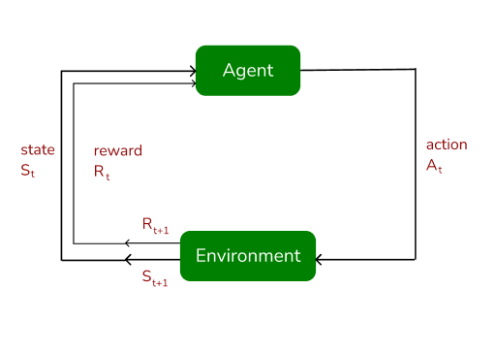
1. Observation/State
The agent observes the current state of the environment.
2. Action
Based on its observations and its learned policy, the agent selects an action to perform.
3. Response/Reward
The environment transitions to a new state and provides a reward (positive or negative) to the agent.
4. Repeat
This cycle repeats, allowing the agent to learn from its experiences and improve its goal-achieving behavior.

Slide 27
Types of RL environment,
Reinforcement Learning (RL) environments can be categorized based on several key characteristics that influence how an agent interacts and learns within them.
1. Observability:
Fully Observable (Markov Decision Process - MDP):
The agent has complete access to the current state of the environment, meaning its observation directly reflects the true underlying state.

Slide 28
Examples
Chess Game
  The agent (player/AI) can see the entire board, positions of all pieces, and knows the rules.
  There is no hidden information → fully observable.
Self-Driving in Simulation (if sensors give exact, noise-free positions of all cars, pedestrians, signals).

Slide 29
Cont..
Partially Observable (Partially Observable Markov Decision Process - POMDP):
The agent only receives partial information about the environment's state, requiring it to infer the true state based on its observations and past experiences.

Slide 30
Examples
Poker / Card Games
Agent does not know the opponent’s cards.
State is hidden → only partial observations (own cards + table cards).
Robot in a Foggy Room
Robot’s sensors have limited range and noise.
It cannot see the full environment; it only observes nearby walls/objects.
Self-Driving in Real World
Sensors (camera, LiDAR) may fail due to occlusion, bad weather, or blind spots.
The agent doesn’t see the entire road state, only partial signals.
Speech Recognition
At any moment, the system hears only a snippet of audio, not the full sentence structure.

Slide 31
Feature | Fully Observable (MDP) | Partially Observable (POMDP)
State Information | Complete, no hidden details | Incomplete, hidden variables exist
Decision Making | Based on full state | Based on partial observation + memory
Example | Chess, Grid World | Poker, Foggy Navigation

Slide 32
2. Determinism
Deterministic
In a deterministic environment, the next state is fully predictable given the current state and action.
There is no randomness in state transitions or rewards.
Stochastic
In a stochastic environment, the next state is uncertain even if the current state and action are known.
There is randomness in state transitions and/or rewards.
Actions may lead to different next states or rewards with certain probabilities. The outcome is uncertain.

Slide 33
Grid World (without randomness)
If the agent chooses "move right," it always moves exactly one step to the right.
Dice Game
Rolling a die → outcome is uncertain.
Even if you know the action (roll), the result can be 1–6 randomly.

Slide 34
Key Differences
Feature | Deterministic | Stochastic
State Transition | Always fixed & predictable | Randomized, probabilistic
Reward | Always the same for same action | May vary for same action
Example | Chess, Rubik’s Cube, simple maze | Poker, stock trading, real-world driving

Slide 35
3. Action Space
Discrete
The agent chooses from a finite set of predefined actions.
Each action is atomic (no partial control).
Continuous
The agent’s actions are real-valued vectors.
Useful in tasks requiring fine-grained control.

Slide 36
Examples Discrete
Chess / Checkers
Finite states and actions (moving a piece on the board).
Grid World
The agent can move up, down, left, right in discrete cells.
CartPole (discretized actions)
Actions: "push left" or "push right" only.
Tic-Tac-Toe
Limited moves, board positions are discrete.

Slide 37
Example Continuous
Self-Driving Car
Actions: steering angle (0°–360°), acceleration, brake pressure → all continuous.
State: position, velocity, distance, etc. are continuous values.
Robotic Arm Control
Actions: joint angles, torque, velocity – all real-valued.
Drone Navigation
State: position in 3D space (x, y, z ∈ ℝ).
Actions: thrust, pitch, yaw, roll (continuous control).
Stock Market Trading (continuous action version)
Deciding how many units to buy/sell (not just buy/hold/sell).

Slide 38
Key Differences
Feature | Discrete | Continuous
States/Actions | Countable (finite or infinite) | Real-valued (uncountable)
Example | Chess, Grid World, Tic-Tac-Toe | Robotics, Self-driving, Drones
Algorithms | Q-learning, SARSA | DDPG, PPO, A3C, SAC

Slide 39
4. State Space
Discrete: In a discrete environment, the set of possible states the agent can be in is countable (finite or infinite).
The agent knows exactly which "state" it is in, chosen from a limited set.
Often represented by integers, labels, or grid positions.
Continuous: In a continuous environment, the set of possible states is uncountable (infinite real values).
States are described by real numbers (e.g., position, velocity, angle).
Cannot be enumerated one by one.
.

Slide 40
Examples-Discrete
Grid World Maze
States = grid cells (e.g., (x,y) positions).
If a maze has 10×10 = 100 cells → 100 possible states.
Chess Board
States = board configurations (arrangements of pieces).
Each position is a discrete state.
Elevator System
States = floors (e.g., Floor 1, Floor 2, … Floor 10).
Tic-Tac-Toe
States = possible board positions (X and O placements).

Slide 41
Continuous state space
Self-Driving Car
State = (x, y) coordinates, velocity, steering angle, acceleration → all continuous.
Robotic Arm
State = joint angles, angular velocities (real values, not fixed steps).
Pendulum Swing (OpenAI Gym Pendulum-v0)
State = angle θ (in radians), angular velocity ω → both continuous.
Drone in 3D Space
State = (x, y, z) position, orientation, speed → continuous real values.

Slide 42
Comparisons
Feature | Discrete State Space | Continuous State Space
Nature | Countable, finite/infinite | Uncountable, infinite real values
Examples | Chess, Grid World, Tic-Tac-Toe | Self-driving car, Pendulum, Drone
Representation | Integer states, symbolic labels | Real numbers, vectors
Algorithms | Tabular Q-learning, SARSA | Function Approximation, DQN, PPO

Slide 43
5. Episodic Nature
Episodic:
The interaction between the agent and environment is divided into distinct episodes, each with a clear start and end point (e.g., a game that finishes when a goal is reached or the agent loses).
Continuing/Non-Episodic:
The interaction is ongoing without a specific termination point, focusing on maximizing long-term cumulative reward (e.g., a robotic control task that runs indefinitely).

Slide 44
Single-Agent Environment
Only one agent interacts with the environment.
The agent’s actions only affect itself and the environment.
There is no competition or cooperation with other agents.

Slide 45
Examples
Maze Solving Robot
One robot navigates a maze to reach the goal.
Self-Driving Car in Simulation (alone)
Car learns to stay in lane, accelerate, or brake without other cars.
Atari Games (like Breakout, Pong vs. computer wall)
The AI agent plays the game by itself.

Slide 46
Multi-Agent Environment
Multiple agents interact with the environment simultaneously.
Agents can:
Cooperate (work together for a shared goal).
Compete (adversarial, trying to outperform others).
Mix (both cooperation and competition).
The environment becomes dynamic because one agent’s actions affect the state for others.

Slide 47
6. Number of Agents
Chess / Go / Poker
Two agents (players) compete against each other.
Traffic with Multiple Self-Driving Cars
Each car is an agent, they must coordinate to avoid collisions.
Robot Soccer (RoboCup)
Teams of robots (agents) cooperate within teams and compete against opponents.
Stock Market Simulation
Multiple trading agents (buyers, sellers) interact competitively.

Slide 48
RL Simulation Platforms (Environments)
OpenAI Gym → Classic control (CartPole, MountainCar), Atari games, Mujoco tasks.
Gymnasium (successor of OpenAI Gym) → Actively maintained with updated APIs.
DeepMind Control Suite → Physics-based tasks like locomotion, manipulation.

Slide 49
RL Simulation Platforms (Environments)
Atari 2600 ALE → Arcade Learning Environment for Atari games (Pong, Breakout).
Unity ML-Agents → 3D game-like simulations with single/multi-agent setups.
Roboschool / PyBullet → Physics-based robotics simulations.
CARLA → Autonomous driving simulator.
RoboCup Soccer → Multi-agent robot soccer simulation.

Slide 50
RL Libraries & Toolkits
Stable-Baselines3 → Popular PyTorch-based library with standard RL algorithms (DQN, PPO, A2C, SAC, TD3).
RLlib (Ray) → Scalable distributed RL library.
TF-Agents (TensorFlow) → RL agents built with TensorFlow.
Keras-RL2 → Simple RL integration with Keras.
Acme (DeepMind) → Framework for building scalable RL agents.
Horizon (Meta/Facebook) → Production-grade RL platform

Slide 51
Robotics RL Platforms
Mujoco → Physics engine (used with Gym & DeepMind Control Suite).
PyBullet → Open-source physics engine for robotics.
Gazebo → Simulation for real robots (ROS integration).
Webots → Robot simulator for education and research.

Slide 52
Multi-Agent RL Platforms
PettingZoo → Multi-agent equivalent of Gym (supports parallel & sequential play).
Multi-Agent Particle Environment (MPE) → Cooperative/competitive agents in 2D.
StarCraft II Learning Environment (SC2LE) → Multi-agent strategy game (DeepMind).
Pommerman → Multi-agent Bomberman-style environment.

Slide 53
Comparison
Category | Examples
Simulation Environments | OpenAI Gym, Unity ML-Agents, CARLA, Atari ALE
RL Libraries | Stable-Baselines3, RLlib, TF-Agents, Acme, Horizon
Robotics | Mujoco, PyBullet, Gazebo, Webots
Multi-Agent | PettingZoo, SC2LE, Pommerman, MPE

Slide 54
Note
Use Gym / Gymnasium for quick experiments.
Use Stable-Baselines3 / RLlib for ready-made algorithms.
Use Unity ML-Agents / CARLA for advanced 3D simulations.
Use PettingZoo / SC2LE for multi-agent RL.

Slide 55
RL Applications
Domain | Applications (Examples)
Education | Adaptive learning, tutoring, exam scheduling
Healthcare | Treatment planning, robotic surgery, ICU control
Manufacturing | Robotics, production scheduling, quality control
Inventory Mgmt | Stock replenishment, warehouse robots, supply chains
Finance | Algorithmic trading, portfolio optimization, fraud detection
NLP | Chatbots, translation, summarization, speech recognition
Computer Vision | Autonomous driving, medical imaging, object tracking

Slide 56
Note
RL is being applied wherever sequential decision-making under uncertainty is required.
RL is useful when decisions must be made step by step, and the outcome of each decision is not certain.
Example: A robot moving in a maze — at each step it decides where to go, but it doesn’t always know what will happen next.

Slide 57
Q-Learning
What is Q-Learning?
Q-Learning is a model-free, off-policy reinforcement learning algorithm.
It aims to learn the optimal action-value function Q(s, a) which gives the expected utility of taking action a in state s, and following the optimal policy thereafter.
Used when the agent doesn’t know the environment’s dynamics.

Slide 58
Q-Learning
Key Concepts
Term | Meaning
State (s) | The current situation of the environment
Action (a) | The decision taken by the agent
Reward (r) | Feedback received after an action
Q-Value (Q(s,a)) | Expected future reward for taking action a in state s
Learning Rate (α) | Controls how much new info overrides old info
Discount Factor (γ) | Determines importance of future rewards

Slide 59

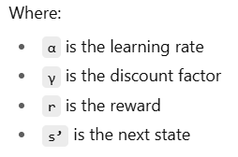
Q-Learning
Q-Learning Update Rule
The Q-value is updated as:

Slide 60
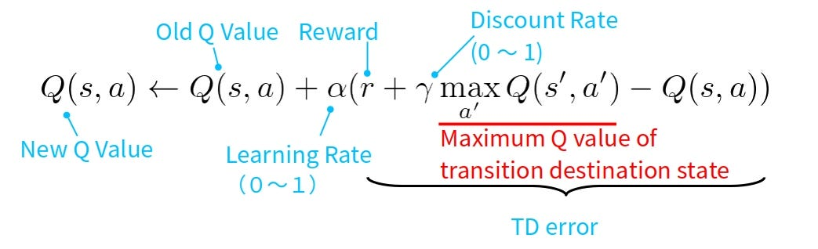
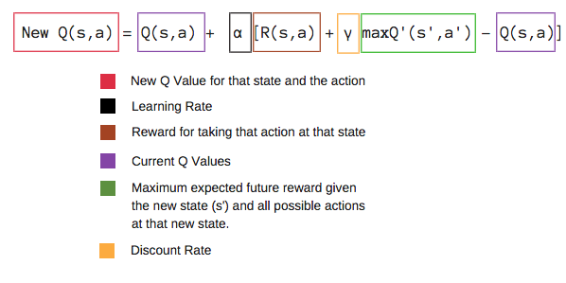
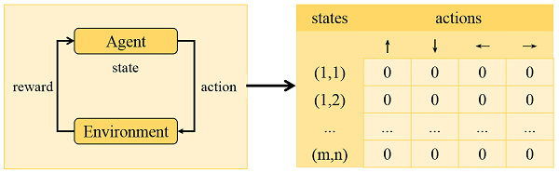
Q-Value Table

Slide 61
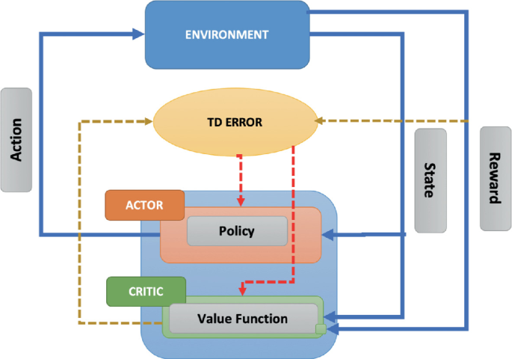
TD Error
TD Error = (Immediate Reward + Discounted Value of Next State) - (Value of Current State)

Slide 62
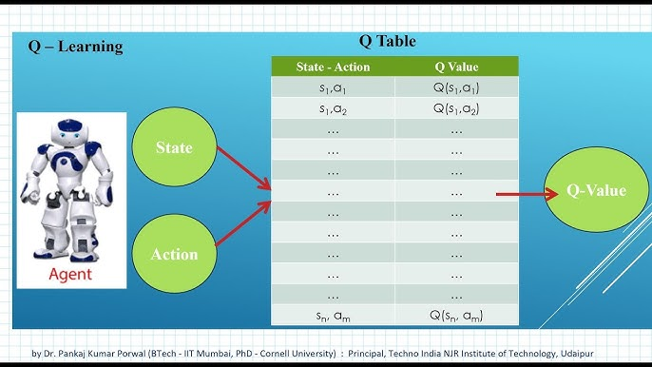
Example

Slide 63
Q-Learning
Q-Learning Algorithm (Pseudocode)
Initialize Q(s,a) arbitrarily
For each episode:
Initialize state s
Repeat:
Choose action a from s using ε-greedy policy
Take action a, observe reward r and next state s'
Q(s,a) ← Q(s,a) + α [r + γ max Q(s’, a’) - Q(s,a)]
s ← s'
until s is terminal

Slide 64
Q-Learning
Q-learning is a Reinforcement Learning (RL) algorithm where an agent learns to take actions in an environment to maximize rewards.
At each step, the agent faces a decision:
Should it explore new actions to discover better rewards?
Or
should it exploit its current knowledge and choose the best-known action?

Slide 65
Exploration
Trying out new or less certain actions, even if they may not give the maximum reward immediately.
Purpose: To discover potentially better actions that the agent doesn’t yet know about.
Risk: Might choose suboptimal actions and get lower rewards temporarily.

Slide 66
Exploitation
Choosing the action that the agent currently believes has the highest Q-value (best known reward).
Purpose: To maximize reward using current knowledge.
Risk: May miss out on discovering better actions in the long run.

Slide 67
Balance Between Exploration and Exploitation
In Q-learning, this is usually handled with the ε-greedy strategy:
With probability ε (epsilon) → explore (choose a random action).
With probability 1 - ε → exploit (choose the best-known action).
Example: If ε = 0.1
10% of the time → random action (exploration).
90% of the time → best action (exploitation).

Slide 68
Example
Imagine a robot in a maze
At the start, the robot doesn’t know which path leads to the exit.
If it always exploits the path it has tried before, it might get stuck in a loop.
If it explores, it may find a shortcut to the exit that gives a higher reward.
Over time, Q-learning adjusts Q-values, and the robot reduces exploration as it learns the best path

Slide 69
Key Insight
Exploration = Learn more, risk short-term loss
Exploitation = Use current knowledge, maximize short-term gain
A good Q-learning agent starts with more exploration and gradually shifts to more exploitation once it has learned enough.

Slide 70
Simple Example
Q-Learning
A | B | C
D | E | F
Goal at state F with reward +10
Agent starts at A
Actions: UP, DOWN, LEFT, RIGHT
Q-learning helps agent learn:
Best path to F
Value of each state-action pair
Over time, Q-values converge to optimal policy.

Slide 71
Q-Learning
Advantages of Q-Learning
Model-free
Simple and effective for discrete environments
Converges to optimal policy under the right conditions
Easy to implement
Limitations of Q-Learning
Struggles with large or continuous state spaces
Requires large Q-table (memory-intensive)
Slower convergence in complex environments

Slide 72
SARSA
Introduction to SARSA
SARSA is an on-policy, model-free temporal-difference learning method.
It learns the Q-value (action-value function) by interacting with the environment and using the actual actions taken by the agent.
You learn from the same strategy you are following.
SARSA stands for:
State → Action → Reward → Next State → Next Action
SARSA vs Q-Learning: Behavior Difference
SARSA: Learns value of actions actually taken (safe)
Q-Learning: Learns value of best actions possible (aggressive)
SARSA behaves conservatively, useful in risky or uncertain environments.

Slide 73
SARSA VS Q-LEARNING
Aspect | On-Policy (e.g., SARSA) | Off-Policy (e.g., Q-learning)
Behavior Policy | Same as target policy | Different from target policy
Exploration | Learns what it actually does | Learns the optimal (greedy) policy even if behavior explores
Update Rule | Uses action actually taken (next action from ε-greedy) | Uses the best possible action (greedy)
Bias & Variance | More biased, safer learning | Less biased, more efficient but riskier
Analogy | Learn from your own driving | Learn from your teacher’s “perfect driving” while you try random moves

Slide 74
What is ε-greedy in Reinforcement Learning?
In RL, when an agent chooses actions, it faces a dilemma:
Exploration → Try new actions to discover better rewards.
Exploitation → Choose the best-known action so far to maximize reward.
The ε-greedy policy is one of the simplest and most popular ways to balance exploration and exploitation.
How ε-greedy works
With probability (1 − ε) → choose the greedy action (the best action according to current Q-values).
With probability (ε) → choose a random action (explore).
Here, ε (epsilon) is a small number between 0 and 1, e.g., 0.1.

Slide 75
SARSA Terminology
Term | Description
State (s) | Current state of the environment
Action (a) | Action taken by the agent
Reward (r) | Reward received after performing the action
Next State (s') | New state after action a is taken
Next Action (a') | Next action selected using same policy

Slide 76
SARSA Algorithm Pseudocode
Initialize Q(s, a) arbitrarily
For each episode:
Initialize state s
Choose action a using policy derived from Q (e.g., ε-greedy)
Repeat for each step of episode:
Take action a, observe reward r and next state s'
Choose action a' using policy derived from Q
Q(s,a) ← Q(s,a) + α [r + γ Q(s', a') − Q(s,a)]
s ← s'; a ← a'
until s is terminal

Slide 77
Advantages of SARSA
On-policy learning ensures consistency
Safer in stochastic or dangerous environments
Easier to implement and understand
Good for real-time learning where decisions affect outcomes
Limitations of SARSA
Slower convergence in some cases
Less optimal than Q-learning in purely deterministic environments
Requires policy consistency for learning stability
Applications of SARSA
Autonomous Navigation
Robot Motion Control
Traffic Signal Optimization
Inventory Management

Slide 78
REINFORCE
REINFORCE is one of the earliest and most fundamental policy gradient algorithms in Reinforcement Learning (RL).
It was introduced by Ronald Williams in 1992.
It is also called the Monte Carlo Policy Gradient (MC-PG) method.
Instead of learning a value function (like Q-learning does), REINFORCE directly learns a parameterized policy πθ(a|s), i.e., a probability distribution of actions given states.
The goal is to adjust the policy parameters (θ) so that actions leading to higher rewards are chosen more often.

Slide 79
Step 1. Run an episode using the current policy πθ.
(Agent interacts with environment until the episode ends.)
Step 2. Compute return (Gₜ) for each time step t.
Gt​=rt​+γrt+1​+γ2rt+2​+…
Step 3. Update the policy parameters using gradient ascent:
θ←θ+αG_{t}​∇_{θ}​log_{πθ}​(a_{t}​∣s_{t}​)
Step 4. α = learning rate
​∇_{θ}​log_{πθ}​(a_{t}​∣s_{t}​)= “log-likelihood trick” (increases probability of good actions)
Gₜ = return (tells us how good the action was)

Slide 80
Key Idea
If an action leads to high return, increase its probability.
If an action leads to low return, decrease its probability.
Over time, the policy improves to select better actions.

Slide 81
Example
Imagine a robot lawyer assistant deciding whether to:
(a) search past judgments
(b) draft a template contract
(c) answer a client question
Suppose action (a) led to a high client satisfaction reward → REINFORCE increases probability of choosing (a) in future.
If action (c) gave poor reward → probability of (c) decreases.

Slide 82
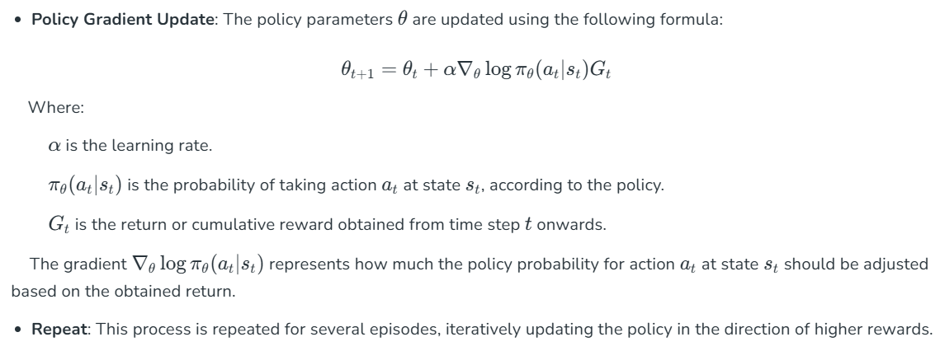

Slide 83
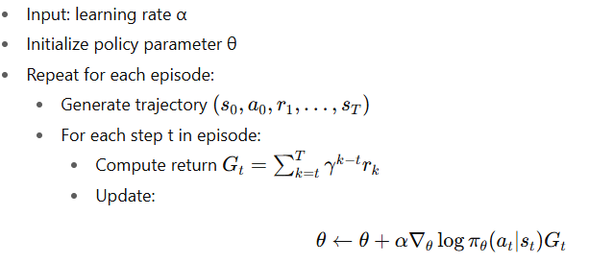
Pseudocode

Slide 84
Advantages
Simple and easy to implement.
Works well with stochastic policies.
Can handle high-dimensional continuous action spaces.
Limitations
High variance in gradient estimates.
Requires complete episodes → inefficient for long horizons.
Slow convergence compared to actor-critic methods.

Slide 85
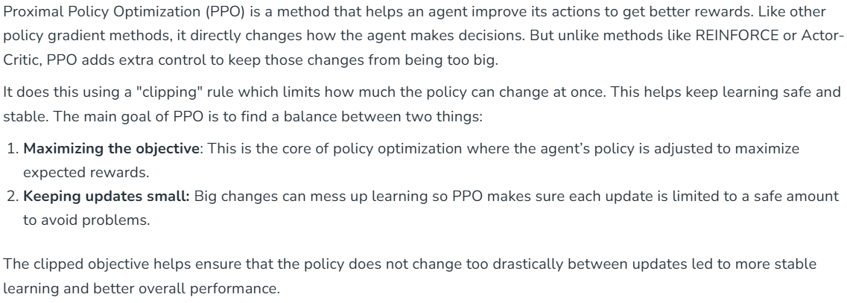
Proximal Policy Optimization (PPO)

Slide 86
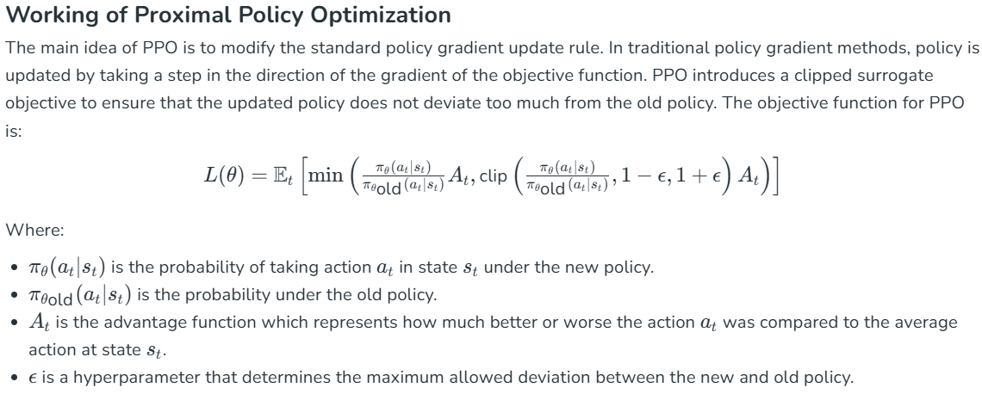

Slide 87
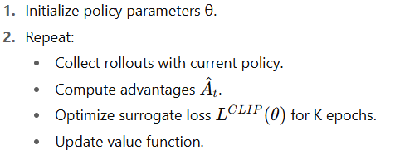
PPO Pseudocode

Slide 88
Advantages of PPO
Stable learning with fewer tuning requirements.
General-purpose RL algorithm.
Works for continuous & discrete action spaces.
Limitations
More computationally expensive than REINFORCE.
Still requires careful hyperparameter tuning (clip ratio, learning rate).
Can be sample inefficient compared to Q-learning in simple tasks.

Slide 89
PPO vs Other Methods
Feature | REINFORCE | PPO
Stability | Low | High
Complexity | Low | Medium
Sample Efficiency | Low | High
Practical Use | Rare | Very Common

Slide 90
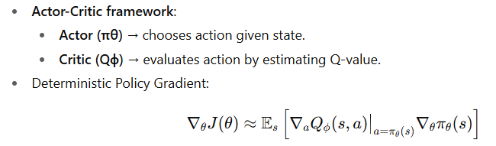
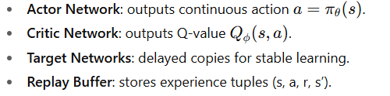
Deep Deterministic Policy Gradient (DDPG)
Key Idea
DDPG Architecture

Slide 91
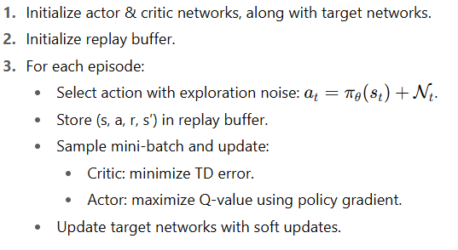
Algorithm Overview

Slide 92
Advantages
Handles continuous and high-dimensional action spaces.
More sample-efficient than pure policy gradient methods.
Limitations
Sensitive to hyperparameters (learning rate, noise).
Overestimation bias in critic network.
Can be unstable without proper tuning.

Slide 93
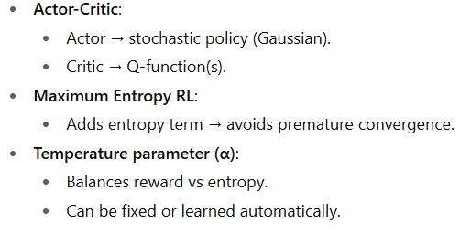
Soft Actor-Critic (SAC)
Introduction
SAC is a state-of-the-art actor-critic algorithm.
Designed for continuous action spaces.
Combines:
  Off-policy learning (efficient use of data).
  Maximum entropy framework (better exploration & robustness)
Key Concepts

Slide 94
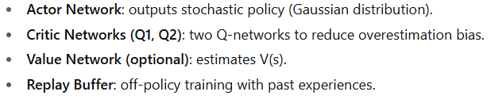
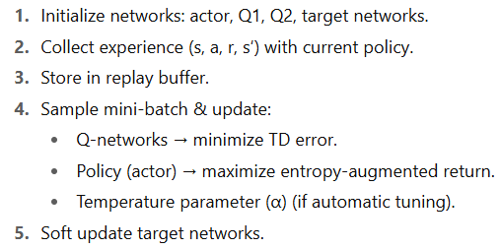
SAC Architecture
SAC Algorithm Overview

Slide 95
Advantages of SAC
Encourages exploration via entropy regularization.
Off-policy → efficient sample usage.
More stable than DDPG and PPO in many environments.
Learns stochastic policies (useful in uncertain tasks).
Limitations of SAC
More computationally expensive (two critics, entropy term).
Sensitive to entropy coefficient tuning.
May underperform in purely deterministic environments.

Slide 96
Comparison with Other Algorithms
Feature | DDPG | SAC
Policy Type | Deterministic | Stochastic
Action Space | Continuous | Continuous
Exploration | Noise-based | Entropy-driven
Stability | Medium | Very High
Sample Efficiency | Medium | High

Slide 97
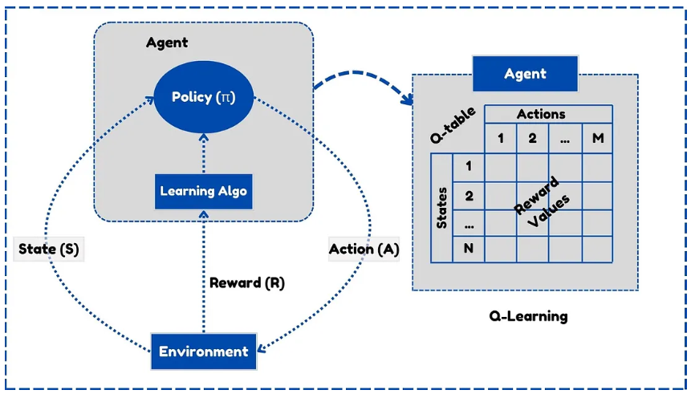
Elements of RL: Agent, Policy function, Value function, Model Agent environment interface

Slide 98
Introduction
Reinforcement Learning (RL) is a trial-and-error learning paradigm.
The agent learns from interaction with the environment.
Core idea: maximize cumulative reward.
RL involves:
  Learning what to do (policy)
  Evaluating actions (value function)
  Modeling environment dynamics (model)
Agent
Definition: Entity that learns, makes decisions, and acts.
Characteristics:
  Has a policy for action selection.
  Updates its knowledge based on rewards.
Examples:
  Self-driving car (agent) deciding speed/steering.
  Chess AI (agent) deciding moves.

Slide 99
Environment
Definition: Everything external to the agent that it interacts with.
Determines how actions change the world.
Provides:
  New state (s′)
  Reward (r)
Examples:
  Road network for autonomous cars.
  Game board for chess AI.
Policy Function (π)
Definition: The agent’s strategy for choosing actions.
Formally: π(a|s) = probability of taking action a in state s.
Types of policies:
  Deterministic: π(s) → always one action.
  Stochastic: π(a|s) → action chosen probabilistically.
Role: Directs the agent’s behavior.
Example:
  Robot: "If obstacle is close → turn left; else move forward."

Slide 100
Value Function
Evaluates how good it is to be in a given state or to take a given action.
State Value Function (Vπ(s)):
  Expected long-term return starting from state s.
Action Value Function (Qπ(s,a)):
  Expected return starting from state s, taking action a.
Importance:
  Helps distinguish good vs bad states/actions.
Example:
  In chess, V(s) estimates winning probability from board state s.

Slide 101
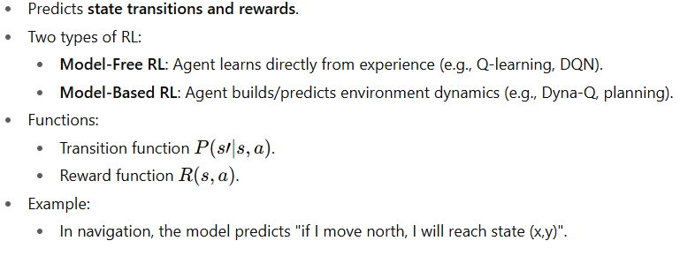
Model of the Environment

Slide 102
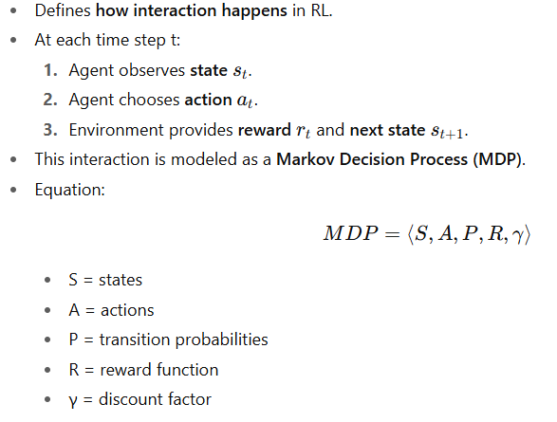
Agent–Environment Interface

Slide 103
RL Loop Diagram
Agent → Action → Environment → State, Reward → Agent
Highlights continuous cycle of learning.
Putting It All Together
Agent uses policy to pick actions.
Environment gives reward and next state.
Agent updates using value function (to evaluate) or model (to plan).
The interface ensures interaction is systematic.

Slide 104
Types of RL environment
Deterministic environment
Stochastic environment
Fully observable environment
Partially observable environment
Discrete environment
Continuous environment
Episodic and non-episodic environment
Single and multi-agent environment

Slide 105
Environment Type | Description | Characteristics | Examples
Deterministic | The next state is completely determined by the current state and action. | - No randomness- Predictable outcomes | Chess (idealized), Maze with fixed paths
Stochastic | The next state is probabilistic, depending on the current state and action. | - Randomness in outcomes- Uncertainty in state transitions | Dice games, Stock market trading
Fully Observable | The agent has complete information about the environment’s current state. | - No hidden states- Decision based on full state | Chess, Tic-Tac-Toe
Partially Observable | The agent has limited or incomplete information about the environment’s state. | - Hidden states exist- Requires memory or inference | Poker, Robot navigation with limited sensors
Discrete | The state and action spaces are finite and countable. | - Limited number of states/actions- Easier to compute policies | Gridworld, Board games

Slide 106
Environment Type | Description | Characteristics | Examples
Continuous | The state or action spaces are infinite or continuous. | - Requires function approximation- Complex learning | Robot arm control, Autonomous driving
Episodic | Interaction is divided into episodes with a clear start and end. | - Rewards accumulate per episode- Environment resets after episode | CartPole, MountainCar
Non-episodic / Continuing | Interaction goes on indefinitely without clear episodes. | - Rewards accumulate indefinitely- No automatic reset | Stock trading, Online recommendation systems
Single-agent | Only one agent interacts with the environment. | - No competition or cooperation- Simplest RL setup | Maze solving, CartPole
Multi-agent | Multiple agents interact in the environment. | - Cooperation or competition- Complex dynamics | Soccer simulation, Multi-robot coordination

Slide 107
Deterministic environment
Deterministic environment is one where the outcome of an action taken in a given state is always the same. This means that if an agent takes a specific action in a particular state, it will always transition to the same next state and receive the same reward. There is no randomness or uncertainty in the state transitions or rewards.
Key characteristics of deterministic environments in RL
No randomness
Unlike stochastic environments, there are no probabilistic elements influencing the transitions
Predictable outcomes:
The next state and reward are entirely determined by the current state and the action taken.
Complete Information
Simplified learning: Learning in deterministic environments can sometimes be more straightforward as the agent does not need to account for uncertainty. Algorithms like Dynamic Programming can be highly effective in known deterministic environments.

Slide 108
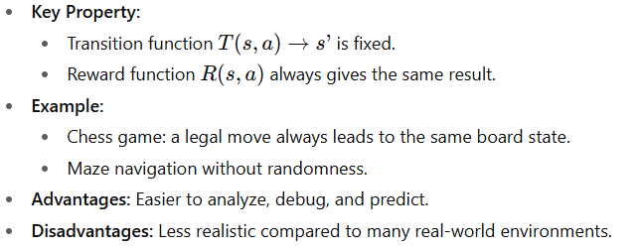

Slide 109
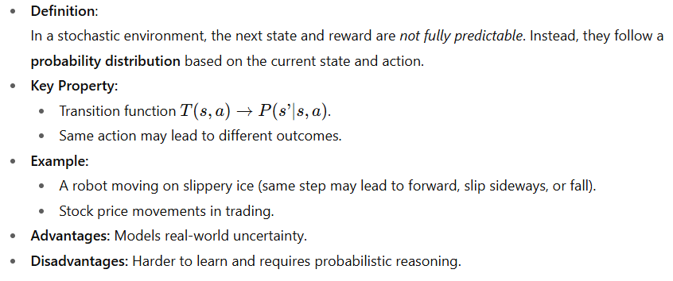
Stochastic environment

Slide 110
Key characteristics and implications of stochastic environments in reinforcement learning:
Uncertainty in Transitions: When an agent takes an action, the next state it lands in is determined by a probability distribution, not a fixed outcome.
Uncertainty in Rewards: The reward received after taking an action might also be probabilistic, meaning the same action in the same state could yield varying rewards.
Need for Robust Policies: Agents in stochastic environments must learn policies that are robust to this inherent uncertainty.
Exploration-Exploitation Trade-off: The presence of stochasticity can complicate the exploration-exploitation trade-off.
Algorithms for Stochastic Environments: Many standard reinforcement learning algorithms, such as Q-learning and SARSA, are designed to handle stochastic environments by updating value estimates based on expected future rewards, averaging over the possible outcomes.
Real-world Relevance: Most real-world applications of reinforcement learning, such as autonomous driving, robotics, or financial trading, involve stochastic environments due to factors like sensor noise, unpredictable external events, or inherent system variability.

Slide 111
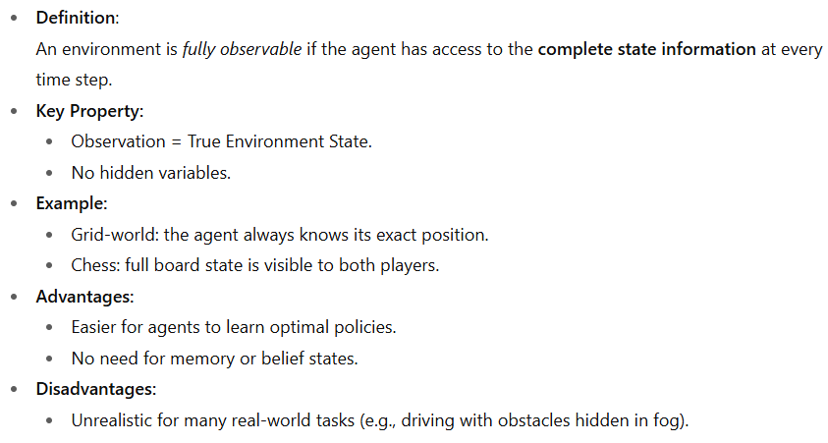
Fully observable environment

Slide 112
Key characteristics of a fully observable environment in RL:
Complete State Information:
The agent can perceive every relevant aspect of the environment that influences its decision-making. There are no hidden variables or unknown elements that could impact the outcome of actions.
No Need for State Estimation:
Since the full state is directly available, the agent does not need to infer or estimate the true state based on partial observations or past experiences. This simplifies the learning process.

Slide 113
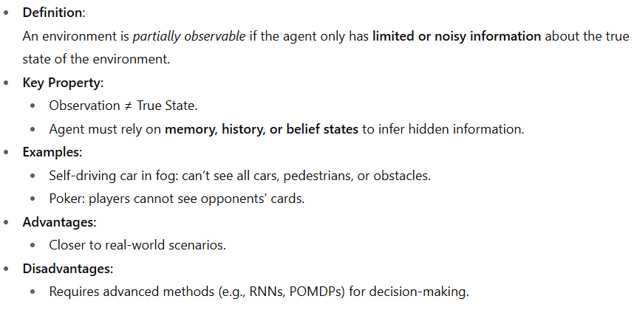
Partially observable environment

Slide 114
Key characteristics :
State Ambiguity:
The same observation can correspond to different underlying states, making it difficult for the agent to infer its true situation.
Memory Requirement:
The agent needs a mechanism to remember past observations and actions to build a more complete understanding of the environment and resolve state ambiguities.
Exploration-Exploitation Trade-off:
The agent must balance exploring the environment to gain more information about the hidden state and exploiting its current knowledge to maximize rewards.

Slide 115
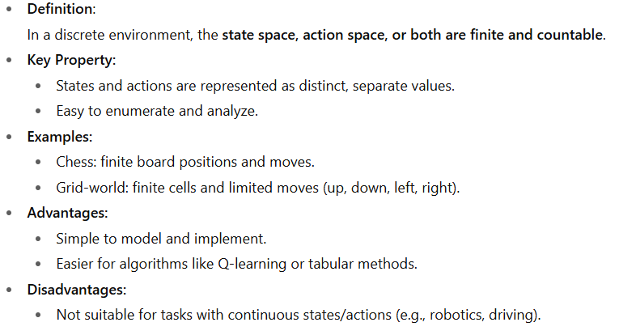
Discrete environment

Slide 116
Key characteristics of discrete environment reinforcement learning include:
Discrete Action Space:
The set of possible actions an agent can take at any given time is limited to a finite number of distinct choices. Examples include moving up, down, left, or right in a grid world, or choosing from a predefined set of moves in a game like chess.
Discrete State Space:
The set of possible states the environment can be in is also finite and countable. For instance, in a maze navigation problem, each cell in the maze can represent a distinct state.
Value-Based Methods:
Algorithms like Q-learning and SARSA are commonly used in discrete environments. These methods learn a value function (or Q-function) that estimates the expected future reward for taking a specific action in a given state. Since the states and actions are discrete, these values can often be stored in a table (e.g., a Q-table).
Challenges with Large Discrete Spaces:
While discrete environments simplify some aspects of RL, dealing with very large discrete state or action spaces can still pose challenges. As the number of states or actions grows, storing and updating value functions becomes computationally expensive and may require function approximation techniques, even in discrete settings.

Slide 117
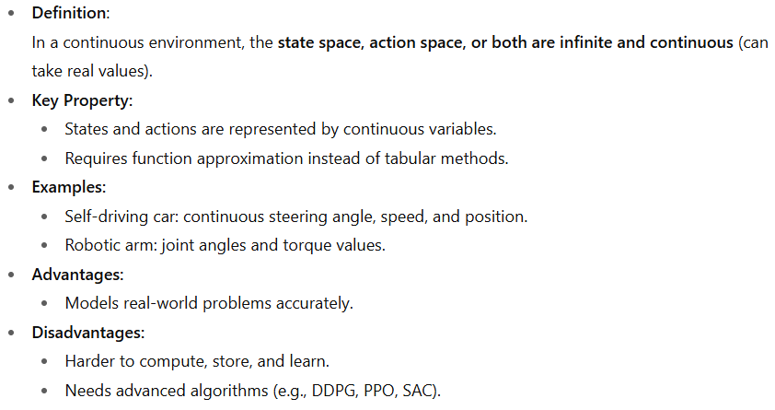
Continuous environment

Slide 118
Key aspects of continuous environment RL:
Continuous State Spaces:
The agent's observations of the environment are represented by continuous values, such as the position and velocity of a robot arm or the temperature readings in a control system.
Example: Self-Driving Car
State = Position (x, y coordinates), speed, acceleration, steering angle.
All values can vary continuously.
Continuous Action Spaces:-
In continuous action space, the possible actions are real values from a continuous range, not discrete choices.
This means the agent can select from infinitely many possible actions.
Example : Self-Driving Car (Steering Angle & Speed Control)
Action = Steering wheel angle (can be any value between -30° and +30°).
Action = Acceleration (e.g., between 0 and 100%).
Both are continuous, not just left/right or accelerate/brake.

Slide 119
Episodic and non-episodic environment
Episodic Environment
Definition: The agent’s experience is divided into independent episodes.
Each episode has a clear beginning and end.
The agent’s action in one episode does not affect future episodes.
Examples:
Medical diagnosis (each patient’s case is separate).
Image classification (each image is independent).
Episode 1 → [State → Action → Reward → End]
Episode 2 → [State → Action → Reward → End]
Episode 3 → [State → Action → Reward → End]
(No dependency between episodes)

Slide 120
The key characteristics of an episodic environment :
Episode Reset: At the beginning of each new episode, the environment is reset to a randomly initialized state, ensuring that the agent's previous actions and observations do not influence the new episode.
Independent Episodes: Each episode stands alone and has no bearing on what has happened or will happen in the next episode. The state and dynamics of the environment are not significantly affected by the agent's observations and actions during the game.
Terminal State: Generally, a scenario doesn't end until a terminal or final state—either a success or a failure—is reached, or the deadline has passed.
Clear Boundaries: There are clean-cut inputs between different episodes and this process helps the agent to extract a lesson learned from earlier episodes and adjust its behaviour in upcoming episodes.

Slide 121
Non-Episodic (Sequential) Environment
Definition: The current action affects future states and rewards.
Experiences are sequentially linked, not independent.
Long-term planning is crucial.
Examples:
Playing chess (every move affects the next state).
Driving a car (current steering affects future position).
State 1 → Action → State 2 → Action → State 3 → Action → ... (continuous)
(Each step depends on the previous one)

Slide 122
The key characteristics of a sequential (non-episodic) environment are as follows:
Temporal Dependency: A stimulus-output-reward loop is crucial in which the states and the actions of the agent in the past determine the present state of the environment and work at creating rewards for the agent.
Non-Resetting Environment: Every time an episode or trial ends, the environment in which the agent functions is not repeatedly reinitialized to some fixed initial value. Instead, the world evolves dynamically as the agent reacts to its current state, with actions influencing future states.
Long-Term Consequences: The actions of an agent can have far-reaching impacts that are not immediately clear and so required the agent to think of the long term implication of its decisions at all times.
Persistent State: The environment maintains a persistent state that sets the background context for each step, and the results of the agent's actions and perceptions are based on that perpetual state.

Slide 123
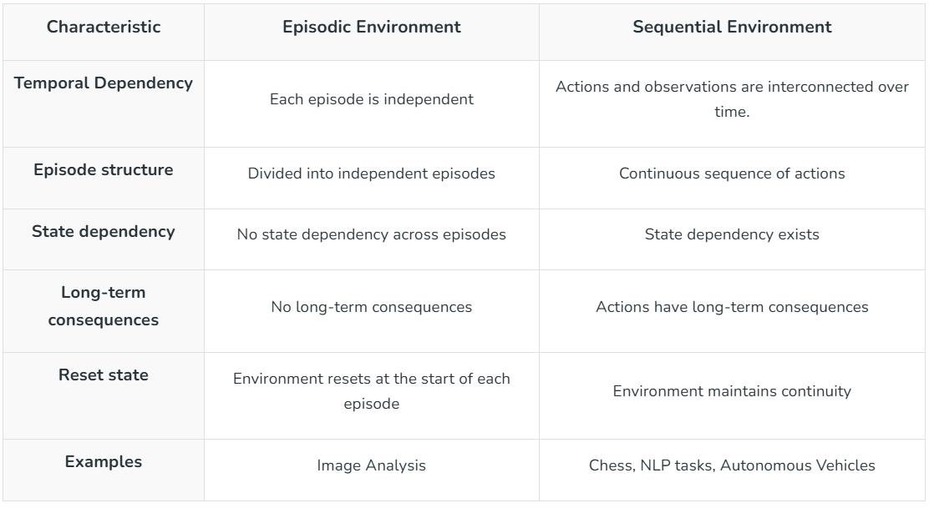

Slide 124
Single and multi-agent environment
Single-Agent Environment
Definition:
An environment where only one agent is interacting with the environment to achieve its goal.
Characteristics:
  No competition or collaboration with other agents.
  The agent’s performance depends only on its own actions.
  Easier to analyze and design strategies.
Examples:
  Chess against a computer program (if only one agent is considered as the decision-maker).
  Robot vacuum cleaner cleaning a house.
  Route planning in Google Maps (only one driver’s route is considered).

Slide 125
Multi-Agent Environment
Definition:
An environment where two or more agents interact, either cooperatively or competitively.
Characteristics:
  Agents’ actions affect one another.
  Can involve competition, cooperation, or a mix of both.
  Requires more complex strategies (game theory often applies).
Types of Multi-Agent Environments:
  Cooperative Multi-Agent Environment – agents work together for a common goal.
    Example: Rescue robots working together in disaster management.
  Competitive Multi-Agent Environment – agents have conflicting goals.
    Example: Chess or Poker (two opponents competing).
  Mixed Multi-Agent Environment – includes both cooperation and competition.
    Example: Traffic system (drivers cooperate to follow rules but also compete for fastest routes).

Slide 126
Key Differences
Aspect | Single-Agent Environment | Multi-Agent Environment
Number of Agents | Only one | Two or more
Interaction | No direct interaction with others | Agents interact with each other
Strategy | Depends only on agent’s own actions | Must consider other agents’ actions
Examples | Robot vacuum, route planning | Chess, poker, traffic simulation, multi-robot systems

Slide 127
RL platforms
OpenAI Gym and Universe
DeepMind Lab
RL-Glue
Project Malmo
ViZDoom

Slide 128
Introduction to RL Platforms
Definition: Platforms that provide standardized environments, benchmarks, and APIs to test RL algorithms.
Importance:
  Provide reproducible benchmarks
  Allow comparison of algorithms
  Enable realistic simulations
OpenAI Gym
Developer: OpenAI
Features:
  Large variety of environments: classic control, Atari, robotics
  Standard API for easy integration with PyTorch/TensorFlow
  Community support, extensions available
Applications:
  Testing RL algorithms
  Benchmarking models

Slide 129
Cont..
Classic Control = Simple, mathematical problems (for basic testing).
Atari Games = Complex visual + sequential decision-making (for deep RL).
Robotics = Realistic control problems with continuous spaces (for practical applications).

Slide 130
Categories of Environments
Classic Control
Small, simple benchmark problems used since the early days of RL.
Examples:
  CartPole → balance a pole on a moving cart.
  MountainCar → get a car up a steep hill using momentum.
  Acrobot → swing a double pendulum to reach a goal.
Purpose: Easy to simulate, helps test basic RL algorithms quickly.

Slide 131
2. Atari Environments
Based on Atari 2600 video games provided by the OpenAI Gym benchmark.
Examples:
  Breakout (bounce a ball to break bricks).
  Pong (table tennis game).
  Space Invaders, Pac-Man, etc.
Purpose: Games are visually rich (pixel input) and have discrete actions, making them great for testing deep RL methods like Deep Q-Networks (DQN).

Slide 132
Robotics Environments
Simulated (or real) robotic tasks to test RL in continuous action/state spaces.
Examples:
  A robotic arm picking and placing objects.
  Humanoid walking in simulation.
  Drone flight control.
Purpose: Tests real-world challenges such as control precision, noise, and safety.

Slide 133
OpenAI Universe
Developer: OpenAI
Features:
  RL across apps, games, and websites
  Multitask learning with real-world scenarios
  Tests general intelligence
Applications:
  Broad AI agent training
  Human-like learning in diverse tasks
DeepMind Lab
Developer: DeepMind
Features:
  3D first-person navigation and puzzles
  High-dimensional visual input
  Maze-like environments requiring exploration & memory
Applications:
  Cognitive mapping research
  Deep RL in 3D perception environments

Slide 134
RL-Glue
Developer: University of Alberta
Features:
  Lightweight framework for RL research
  Language-independent (supports multiple programming languages)
  Standard communication protocol between agent, environment, experiment
Applications:
  Teaching RL concepts
  Comparing algorithms across environments
Project Malmo
Developer: Microsoft Research
Features:
  Built on Minecraft
  Highly customizable tasks
  Multi-agent support
  Rich 3D environment for exploration, building, collaboration
Applications:
  Multi-agent RL
  AI safety, general intelligence experiments

Slide 135
ViZDoom
Developer: Intel Labs & University of Wrocław
Features:
  Based on Doom FPS game
  Visual and tactical decision-making challenges
  Custom scenario creation (combat, navigation, survival)
Applications:
  Vision-based RL
  Autonomous navigation & combat learning

Slide 136
Platform | Developer | Focus / Environment Type | Key Features | Use Cases
OpenAI Gym | OpenAI | Classic control tasks, Atari games, robotics (via extensions) | - Standard API for RL- Huge variety of environments- Easy integration with TensorFlow, PyTorch | Benchmarking RL algorithms, prototyping
OpenAI Universe | OpenAI | Real-world applications, games, browsers | - RL across real-world apps (Flash, web, games)- Large-scale general intelligence testing | General AI research, multitask RL
DeepMind Lab | DeepMind | 3D first-person navigation & puzzle-solving | - Rich 3D maze-like environments- High-dimensional visual input- Supports complex tasks | Cognitive mapping, deep RL in 3D

Slide 137
Platform | Developer | Focus / Environment Type | Key Features | Use Cases
RL-Glue | University of Alberta | Framework for RL research (communication standard) | - Provides a standard protocol- Language-independent- Lightweight and flexible | Teaching RL, algorithm–environment separation
Project Malmo | Microsoft | Minecraft-based RL environment | - Built on Minecraft- Highly customizable scenarios- Multi-agent support | Multi-agent RL, world-building tasks, AI safety
ViZDoom | Intel Labs & University of Wrocław | Doom-based First-Person Shooter (FPS) environment | - RL in first-person shooter environment- Focus on visual perception & decision making- Custom scenarios | Vision-based RL, navigation, combat tasks

Slide 138
Applications of RL
Education
Medicine and healthcare
Manufacturing
Inventory management
Finance
Natural Language Processing
Computer Vision

Slide 139
Education
Introduction
Reinforcement Learning (RL) in education is used
to create personalized learning experiences through intelligent tutoring systems and adaptive content
generate educational materials like quizzes and videos
provide real-time feedback and hints to students
and build simulations of student behaviors to understand learning processes

Slide 140
Adaptive Tutoring: RL agents can adapt to a student's learning style and knowledge gaps, providing customized learning paths and content to improve effectiveness.
Emotional and Social Support: RL can analyze student emotional responses and social interactions, offering timely support and guidance to develop emotional regulation and social skills.
Automated Content Creation: RL techniques can be employed to produce various educational materials, including quizzes, exercises, and even videos, tailored to specific learning goals.
Platform Optimization: RL can be used in educational platforms to determine the most effective versions of learning technologies or content by observing student learning outcomes.
Simulating Student Behavior: RL can simulate student behavior by treating the student as the agent and the teacher or platform as the environment, providing a deeper understanding of how students learn and interact with educational content.
Improving Learning Outcomes: By enabling systems to align with individual student needs, RL can precisely enhance learning efficacy and outcomes, ensuring students learn at their optimal pace and comprehension level.

Slide 141
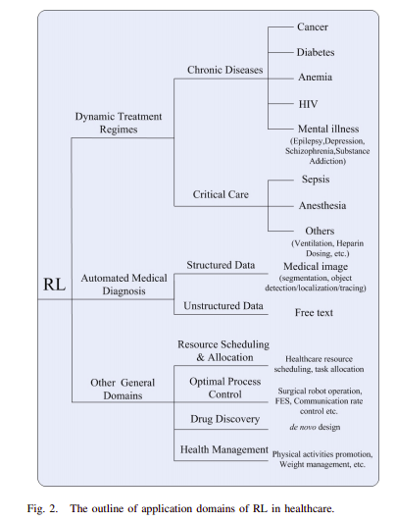
Medicine and healthcare

Slide 142
Personalized Treatment Optimization
Dynamic Treatment Regimes (DTRs): RL creates personalized treatment strategies for chronic conditions by learning from patient data.
Cancer Treatment: RL optimizes chemotherapy and radiation schedules by considering patient-specific responses to improve long-term outcomes.
Intensive Care Unit (ICU) Management: RL helps manage patient conditions and optimize ventilator settings to minimize mortality and improve physiological stability.
Enhancing Clinical Decision Support and Automation
Clinical Decision Support Systems (CDSSs): RL powers CDSSs, which provide AI-driven recommendations and suggest optimal treatment pathways by continuously learning from new patient cases and historical outcomes.
Personalized Antidepressant Treatment: RL models learn to adapt and personalize antidepressant treatment plans to individual patient responses

Slide 143
Improving Healthcare Operations
Resource Management: RL optimizes hospital resource allocation, including scheduling surgeries, assigning ICU beds, and predicting emergency department admissions to minimize bottlenecks.
Medical Imaging: RL agents can guide image analysis by focusing computational power on regions of interest in medical scans, improving the speed and accuracy of anomaly detection.
Advancing Robotic Surgery: In robotic surgery, RL enhances motion planning and precision control, improving patient safety during procedures.

Slide 144
Manufacturing
Predictive Maintenance: RL algorithms can learn to predict when equipment is likely to fail by analyzing operational data, allowing for proactive maintenance and minimizing costly downtime.
Robotics and Automation: Robots learn to perform tasks in complex environments, optimizing movements and efficiency for tasks like material handling and assembly, often in conjunction with other AI techniques like deep learning.
Production Scheduling and Control: RL enables dynamic, real-time adjustment of production plans to unexpected changes, such as machine breakdowns, ensuring smoother workflow and better resource allocation.
Quality Control: By continuously learning from sensor data, RL can help to fine-tune processes and identify defects, leading to higher product quality and reduced negative customer feedback.
Energy Optimization: RL can be used to optimize energy consumption in manufacturing operations by learning how to best manage power usage, resulting in cost savings and a reduced environmental impact.
Warehouse Management: RL algorithms can optimize warehouse operations, including inventory management, order picking, and routing for mobile robots, to improve efficiency and resource use.

Slide 145
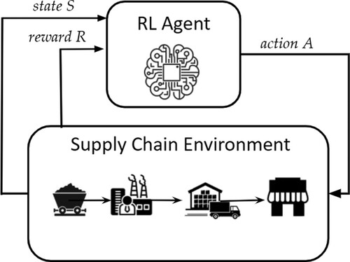
Inventory management

Slide 146
Dynamic Ordering Decisions: RL agents learn to make dynamic decisions on when and how much to order by observing past outcomes and continuously improving their strategies, unlike traditional methods that rely on fixed assumptions.
Cost Minimization: The primary goal of RL in inventory management is to learn an optimal ordering policy that minimizes the total inventory management costs, including holding costs and potential costs from lost sales or backorders.
Service Level Maintenance: By balancing cost reduction with maintaining high service levels, RL helps ensure that customers' demands are met efficiently without excessive overstocking.
Automated Stock Replenishment: RL can automate the re-supply process, integrating real-time data from sensors and systems to ensure a consistent flow of goods.

Slide 147
Finance
Trading bots with Reinforcement Learning: Bots powered with reinforcement learning can learn from the trading and stock market environment by interacting with it. They use trial and error to optimize their learning strategy based on the characteristics of each and every stock listed in the stock market.
Chatbot-based Reinforcement Learning: Chatbots are generally trained with the help of sequence to sequence modelling, but adding reinforcement learning to the mix can have big advantages for stock trading and finance:
Chatbots can act as brokers and offer real-time quotes to their user operators.
Chatbots can also give suggestions on opening and closing sales values within trading hours.
Risk optimization in peer-to-peer lending:P2P lending is a way of providing individuals and businesses with loans through online services. These online services do the job of matching lenders to their investors.
Portfolio Management: Portfolio Management means taking your client’s assets, putting it into stocks, and managing it on a continuous basis to help the client achieve their financial goals.

Slide 148
Price setting strategies: Complexity and dynamic stock price changes are the biggest challenges in understanding stock prices. In order to understand these properties, Gated Recurrent Unit (GRU) networks work well with reinforcement learning.
Recommendation system: When it comes to online trading platforms, recommendation systems based on reinforcement learning techniques can be a gamechanger. These systems can help in recommending the right stocks to users while trading.
If we combine all of the above points, we could get an automated system constructed to achieve high returns, while keeping the investments as low as possible.

Slide 149
Natural Language Processing
Dialogue Systems and Chatbots: RL trains dialogue systems to generate more natural and engaging responses, optimizing for user satisfaction and achieving specific conversational goals.
Machine Translation: RL can enhance machine translation by optimizing for long-term rewards, such as the overall fluency and quality of translations, rather than just local word-to-word accuracy.
Text Summarization: RL models can be trained to select the most informative sentences or generate coherent summaries.
Text Generation: RL enables the generation of more coherent, diverse, and relevant text by training models to select words and construct sentences.
Question Answering Systems: RL can be used to train question-answering systems to retrieve and synthesize information more effectively.
Content Recommendation Systems: RL in recommendation systems often involves understanding and generating textual descriptions or explanations for recommended items.

Slide 150
Computer Vision
Robotics:
Grasping and Manipulation: Robots can learn to pick up and manipulate objects by receiving rewards for successful grasps and penalties for failure, enabling adaptive behavior in complex environments.
Navigation: RL agents can learn to navigate environments, including unknown or dynamic ones, by interpreting visual input from cameras and learning optimal paths to reach a goal.
Image and Video Analysis:
Object Detection and Localization: RL can improve the accuracy of detecting and pinpointing objects in images and video streams by learning how to effectively scan and analyze visual data.
Image Segmentation: Systems can learn to segment images into meaningful regions.
Object Tracking: RL enables systems to track moving objects in video by learning to predict and follow their trajectories over time.
Feature Extraction and Filtering: RL agents can learn to identify and extract the most relevant visual features and apply filters for specific image processing tasks.

Slide 151
Intelligent Systems and Surveillance:
Traffic and Crowd Analysis: RL can be used with real-time video processing and segmentation to analyze traffic flow, detect anomalies, and understand crowd behavior.
Quality Control: In manufacturing, RL-equipped robots with vision systems can learn to inspect products, detect defects, and ensure high-quality control on production lines.
Medical Imaging:
RL can pre-process and segment complex medical images, like those from CT scans, to aid in diagnosis and treatment planning.
Interactive Perception:
RL is especially suited for "interactive perception," where the system's understanding of the environment through vision is coupled with its actions, and each improves the other over time.

Slide 152
Q-Learning Example
Q-Learning example using a 1-D corridor (states 0..5) where the agent starts at 0 and the goal is 5.
Actions: 0 = left, 1 = right.
Step penalty -1, goal reward +10. This is ideal for learning the mechanics of Q-learning.
Intuition (in 1 sentence)
Q-learning learns a Q(state,action) table that estimates how good it is to take each action in each state, then uses this table to pick actions that maximize long-term reward.

Slide 153
Environment (visual)
[S] - 1 - 2 - 3 - 4 - [G]
0 1 2 3 4 5 (state indices)
Start state = 0.
Goal state = 5 (reward +10 and episode ends).
Every step that is not goal → reward -1.

Slide 154
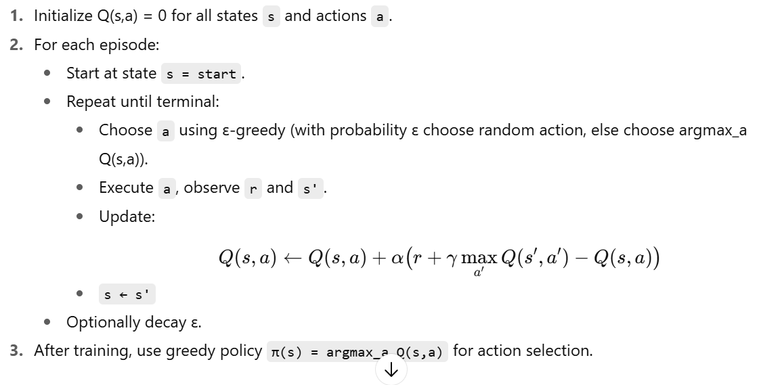

Slide 155

Greedy Policy in RL
A greedy policy is a decision-making strategy where the agent always selects the action with the highest Q-value (or estimated reward) in a given state:

Slide 156
Uses of a Greedy Policy
Exploitation of Learned Knowledge
Once training is complete, the greedy policy ensures the agent consistently chooses the best-known action to maximize reward.
Example: In our corridor example, greedy policy → always move right until reaching the goal.

Slide 157
Evaluation of Learned Strategy
After training with exploration (ε-greedy, softmax, etc.), switching to a greedy policy lets us test the performance of the learned Q-table/policy without randomness.
Deployment Stage
In real-world applications (law automation, robotics, finance, etc.), you don’t want unnecessary exploration once the model is trained.
Greedy policy provides stable and predictable actions.

