Slide 1
Java Installation and Path Setting

Slide 2
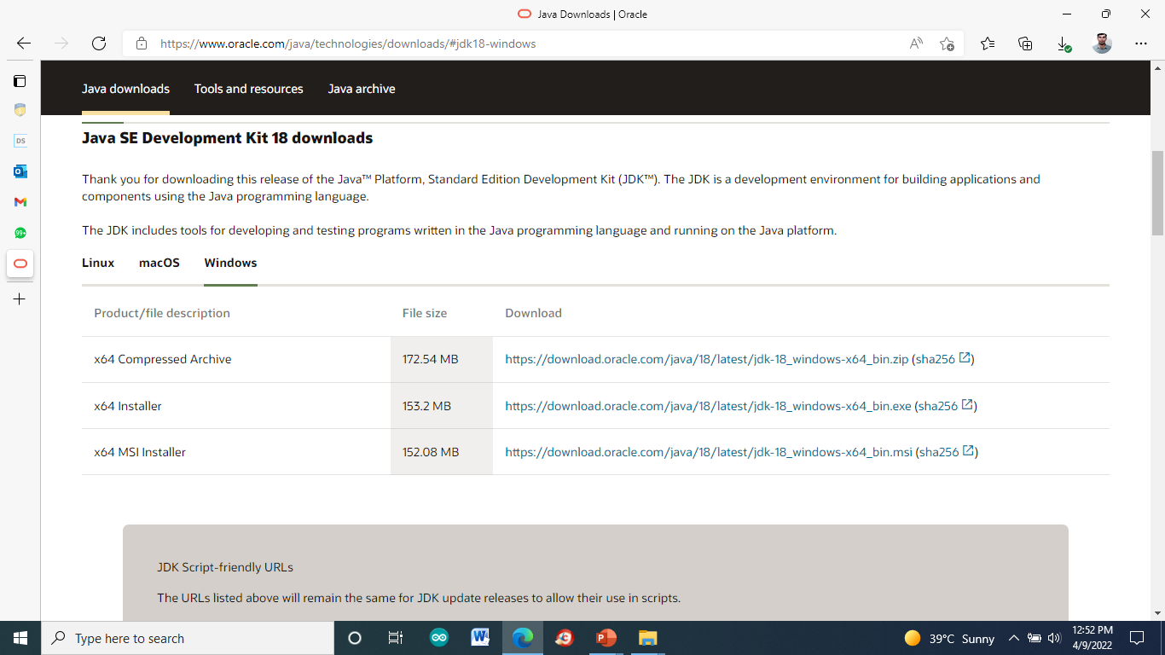
Download Java Installer

Slide 3
Step 1: Run the Downloaded File
Double-click the downloaded file to start the installation.

Slide 4
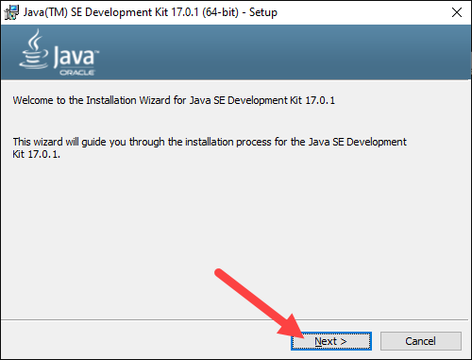
Step 2: Configure the Installation Wizard

Slide 5
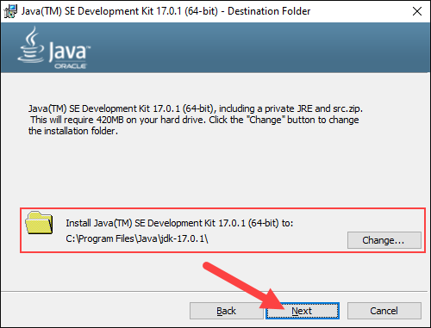
Cont..

Slide 6
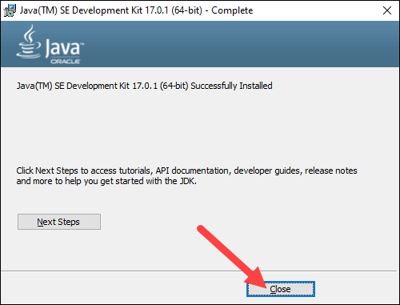
Cont..

Slide 7
Set Environmental Variables in Java
1. Open the Start menu and search for environment variables.
2. Select the Edit the system environment variables result.

Slide 8
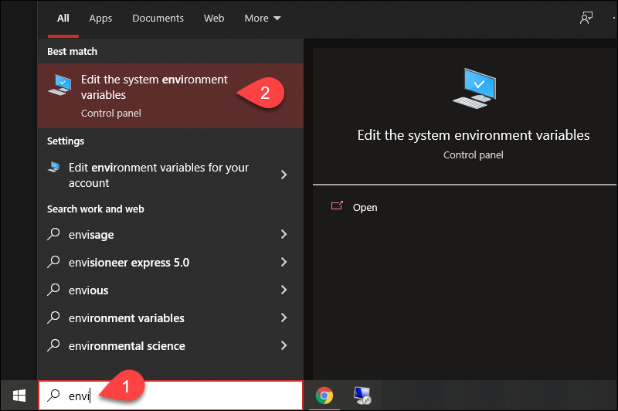
Cont..

Slide 9
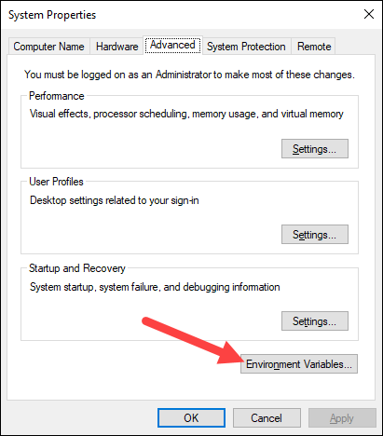
Cont..
3. In the System Properties window, under the Advanced tab, click Environment Variables

Slide 10
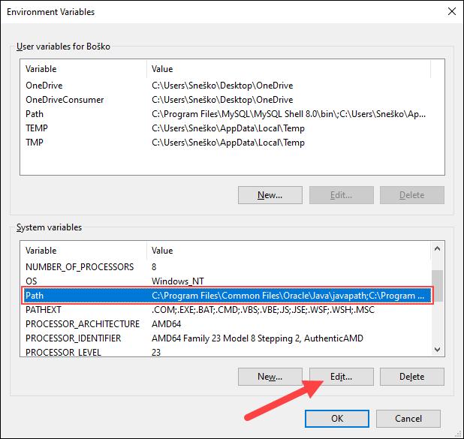
Cont..
4. Under the System variables category, select the Path variable and click Edit

Slide 11
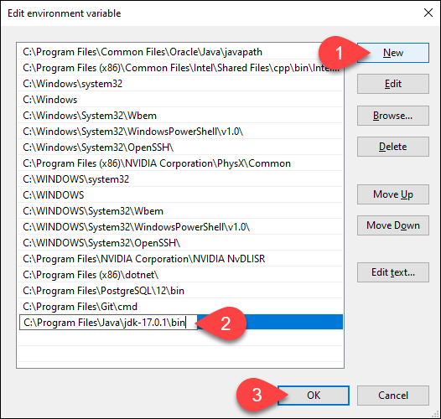
Cont..
5. Click the New button and enter the path to the Java bin directory

Slide 12
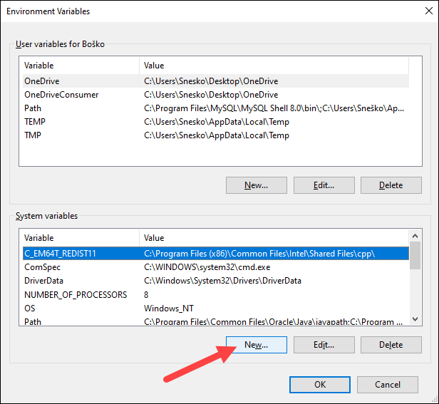
Add JAVA_HOME Variable
1. In the Environment Variables window, under the System variables category, click the New… button to create a new variable.

Slide 13
2. Name the variable as JAVA_HOME

Slide 14
Test the Java Installation
Run the Java –version in the command prompt to make sure java installed correctly

Slide 15
Write a Test Java Script
Open a text editor such as Notepad++ and create a new file
class HelloWorld{
public static void main(String args[]){
System.out.println("Hello world!");
}
}

Slide 16
Cont..

Slide 17
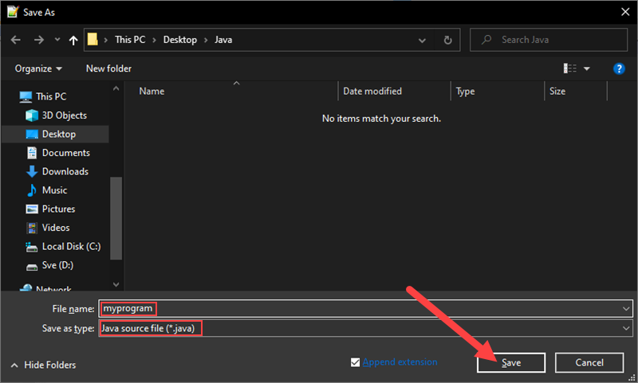
3. Name the file and save it as a Java source file (*.java).

Slide 18
Compile the Test Java Script
In the command prompt, change the directory to the file's location and use the following syntax to compile the program:
Javac [Filename]

Slide 19
Run the program with the following syntax

