Slide 1
How to add Google map inside html page without using API key ?

Slide 2
Cont..
There are two ways to add google maps inside HTML page:
Using API key
Without using API key

Slide 3
To insert google map inside the HTML page, follow the steps:
Go to the google maps and search your desired location.

Slide 4
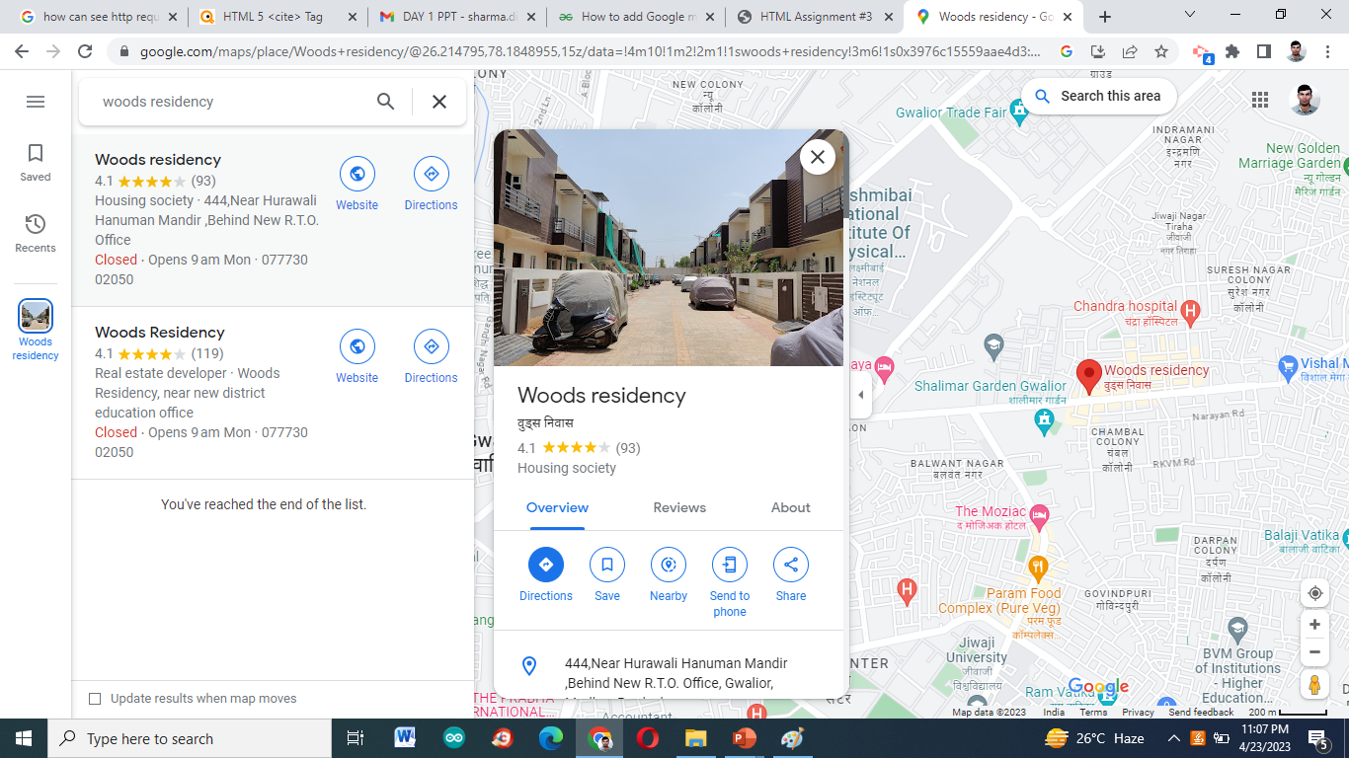

Slide 5
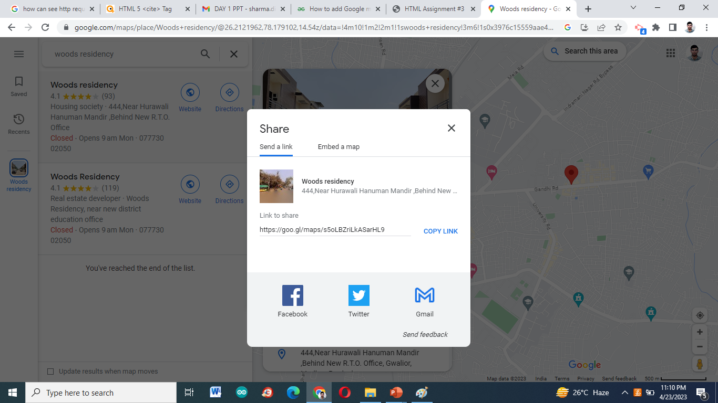
2. Now, you will see share option, click on it.

Slide 6
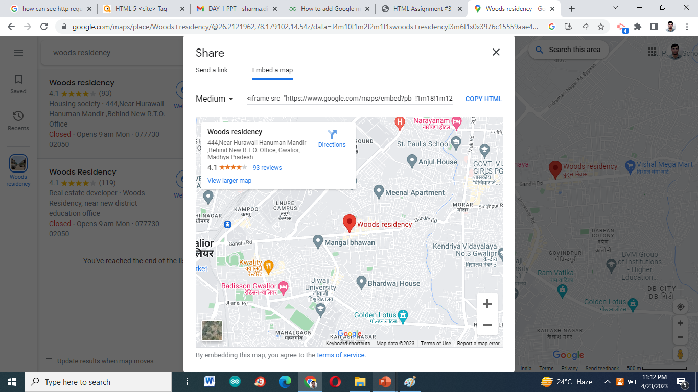
3.Now, a dialog box will appear go to embed a map option.

Slide 7
Cont..
4. A new option will be seen inside the dialog box to copy html. And you can also select the size of the map you want to embed inside your page.

Slide 9
5. Now paste it inside your html page.
<body>
<center>
<h1 style="color:lawngreen;">
Woods Residency
</h1>
<div>
<!-- Google Map Copied Code -->
<iframe src="https://www.google.com/maps/embed?pb=!1m18!1m12!1m3!1d19672.393956688444!2d78.17910200147875!3d26.212196188674707!2m3!1f0!2f0!3f0!3m2!1i1024!2i768!4f13.1!3m3!1m2!1s0x3976c15559aae4d3%3A0x37cd50e7dee06fec!2sWoods%20residency!5e0!3m2!1sen!2sin!4v1682271628511!5m2!1sen!2sin" width="600" height="450" style="border:0;" allowfullscreen="" loading="lazy" referrerpolicy="no-referrer-when-downgrade"></iframe>
</div>
</center>
</body>

