Slide 1
Garbage Collection and Runtime Classes

Slide 2
Garbage Collection
Garbage collection in Java is the process by which Java programs perform automatic memory management. Java programs compile to bytecode that can be run on a Java Virtual Machine, When Java programs run on the JVM, objects are created on the heap, which is a portion of memory dedicated to the program. Eventually, some objects will no longer be needed. The garbage collector finds these unused objects and deletes them to free up memory.

Slide 3
What is Garbage Collection?
In C/C++, a programmer is responsible for both the creation and destruction of objects. Usually, programmer neglects the destruction of useless objects. Due to this negligence, at a certain point, sufficient memory may not be available to create new objects, and the entire program will terminate abnormally, causing OutOfMemoryErrors.

Slide 4
Cont..
In java the programmer need not care for all those objects which are no longer in use. Garbage collector destroys these objects. The main objective of Garbage Collector is to free heap memory by destroying unreachable objects. The garbage collector is the best example of the Daemon thread as it is always running in the background.

Slide 5
How Does Garbage Collection in Java works?
Java garbage collection is an automatic process. Automatic garbage collection is the process of looking at heap memory, identifying which objects are in use and which are not, and deleting the unused objects. An in-use object, or a referenced object, means that some part of your program still maintains a pointer to that object. An unused or unreferenced object is no longer referenced by any part of your program. So the memory used by an unreferenced object can be reclaimed. The programmer does not need to mark objects to be deleted explicitly. The garbage collection implementation lives in the JVM.

Slide 6
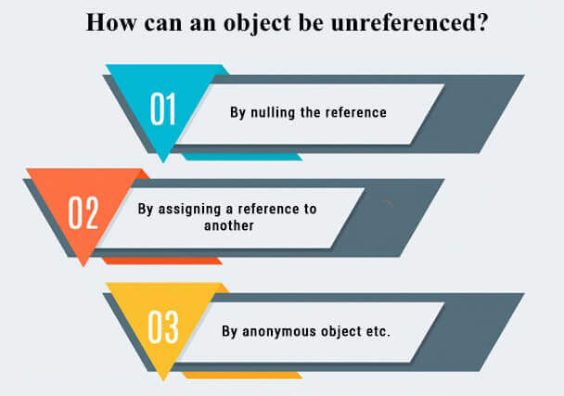
How can an object be unreferenced?

Slide 7
By nulling a reference
Employee e=new Employee();
e=null;

Slide 8
By assigning a reference to another
Employee e1=new Employee();
Employee e2=new Employee();
e1=e2;//now the first object referred by e1 is available for garbage collection

Slide 9
By anonymous object
new Employee();

Slide 10
finalize() method
The finalize() method is invoked each time before the object is garbage collected. This method can be used to perform cleanup processing. This method is defined in Object class as:
protected void finalize(){}

Slide 11
gc() method
The gc() method is used to invoke the garbage collector to perform cleanup processing. The gc() is found in System and Runtime classes.
public static void gc(){}

Slide 12
Example
public class expgar{
public void finalize(){
System.out.println("object is garbage collected");}
public static void main(String args[]){
expgar s1=new expgar();
expgar s2=new expgar();
s1=null;
s2=null;
System.gc();
}
}

Slide 13
Java Runtime classes
Java Runtime classes is used to interact with java runtime environment. Java Runtime class provides methods to execute a process, invoke GC, get total and free memory etc. There is only one instance of java.lang.Runtime class is available for one java application.

Slide 14
Methods of Java Runtime class
No. | Method | Description
1) | public static Runtime getRuntime() | returns the instance of Runtime class.
2) | public void exit(int status) | terminates the current virtual machine.
3) | public void addShutdownHook(Thread hook) | registers new hook thread.
4) | public Process exec(String command)throws IOException | executes given command in a separate process.
5) | public int availableProcessors() | returns no. of available processors.
6) | public long freeMemory() | returns amount of free memory in JVM.
7) | public long totalMemory() | returns amount of total memory in JVM.

Slide 15
Java Runtime exec() method
public class Runtime1{
public static void main(String args[])throws Exception{
Runtime.getRuntime().exec("notepad");
//will open a new notepad
}
}

Slide 16
How to shutdown system in Java
You can use shutdown -s command to shutdown system. For windows OS, you need to provide full path of shutdown command e.g. c:\\Windows\\System32\\shutdown.
Here you can use -s switch to shutdown system, -r switch to restart system and -t switch to specify time delay.

Slide 17
Example
public class Runtime2{
public static void main(String args[])throws Exception{
Runtime.getRuntime().exec("shutdown -s -t 0");
}
}

Slide 18
How to shutdown windows system in Java
public class Runtime2{
public static void main(String args[])throws Exception{
Runtime.getRuntime().exec("c:\\Windows\\System32\\shutdown -s -t 0");
}
}

Slide 19
How to restart system in Java
public class Runtime3{
public static void main(String args[])throws Exception{
Runtime.getRuntime().exec("shutdown -r -t 0");
}
}

Slide 20
Java Runtime availableProcessors()
public class Runtime4{
public static void main(String args[])throws Exception{
System.out.println(Runtime.getRuntime().availableProcessors());
}
}

Slide 21
Java Runtime freeMemory() and totalMemory() method
public class MemoryTest{
public static void main(String args[])throws Exception{
Runtime r=Runtime.getRuntime();
System.out.println("Total Memory: "+r.totalMemory());
System.out.println("Free Memory: "+r.freeMemory());

Slide 22
for(int i=0;i<10000;i++){
new MemoryTest();
}
System.out.println("After creating 10000 instance, Free Memory: "+r.freeMemory());
System.gc();
System.out.println("After gc(), Free Memory: "+r.freeMemory());
}
}

