Slide 1
Services in Android

Slide 2
What is Services
Services in Android are a special component that facilitates an application to run in the background in order to perform long-running operation tasks. The prime aim of a service is to ensure that the application remains active in the background so that the user can operate multiple applications at the same time. A user-interface is not desirable for android services as it is designed to operate long-running processes without any user intervention. A service can run continuously in the background even if the application is closed or the user switches to another application. Further, application components can bind itself to service to carry out inter-process communication(IPC). There is a major difference between android services and threads, one must not be confused between the two. Thread is a feature provided by the Operating system to allow the user to perform operations in the background. While service is an android component that performs a long-running operation about which the user might not be aware of as it does not have UI.

Slide 3
Type of Services
Background Services
Services
Foreground Services
Bound Services

Slide 4
1. Foreground Services
Services that notify the user about its ongoing operations are termed as Foreground Services. Users can interact with the service by the notifications provided about the ongoing task. Such as in downloading a file, the user can keep track of the progress in downloading and can also pause and resume the process.
Example
Phonecall
Camera
Location
Media
Health
Microphone

Slide 5
2. Background Services
Background services do not require any user intervention. These services do not notify the user about ongoing background tasks and users also cannot access them. The process like schedule syncing of data or storing of data fall under this service.

Slide 6
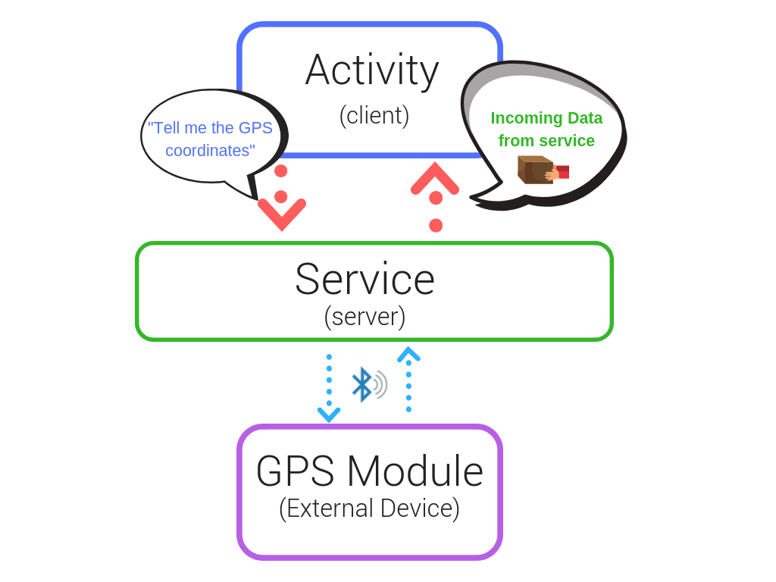
3. Bound Services
This type of android service allows the components of the application like activity to bound themselves with it. Bound services perform their task as long as any application component is bound to it. More than one component is allowed to bind themselves with a service at a time. In order to bind an application component with a service bindService() method is used.

Slide 7
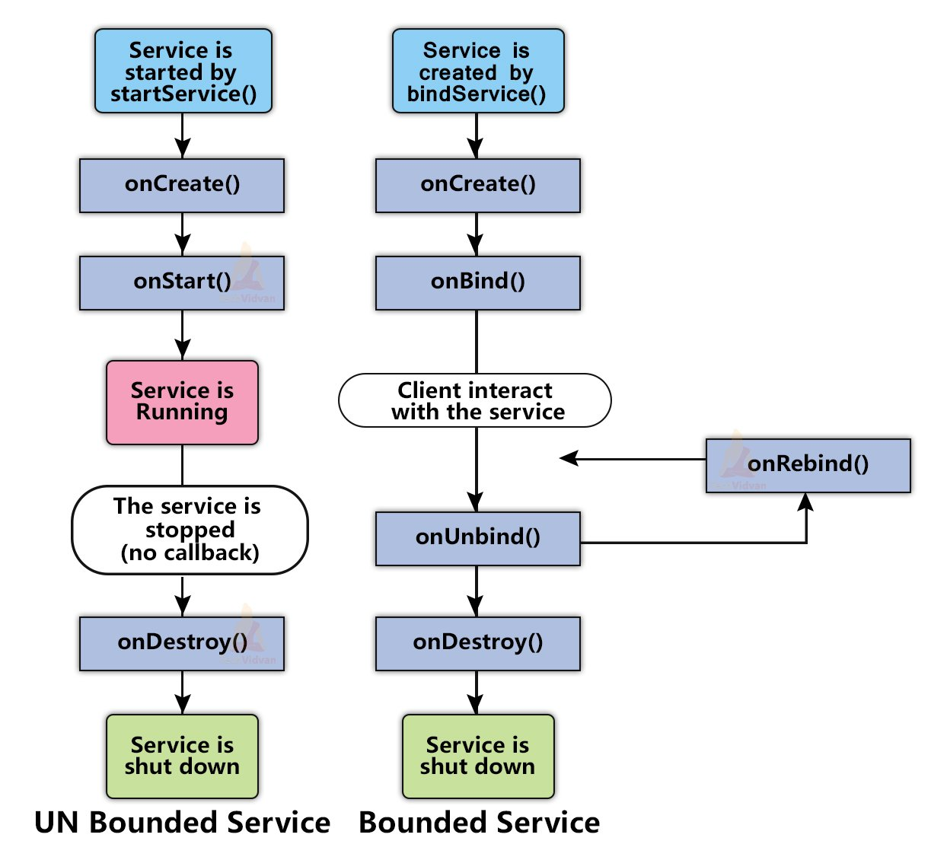
Lifecycle of Android Services

Slide 8
1. Started Service (Unbounded Service)
By following this path, a service will initiate when an application component calls the startService() method. Once initiated, the service can run continuously in the background even if the component is destroyed which was responsible for the start of the service. Two option are available to stop the execution of service:
By calling stopService() method,
The service can stop itself by using stopSelf() method.

Slide 9
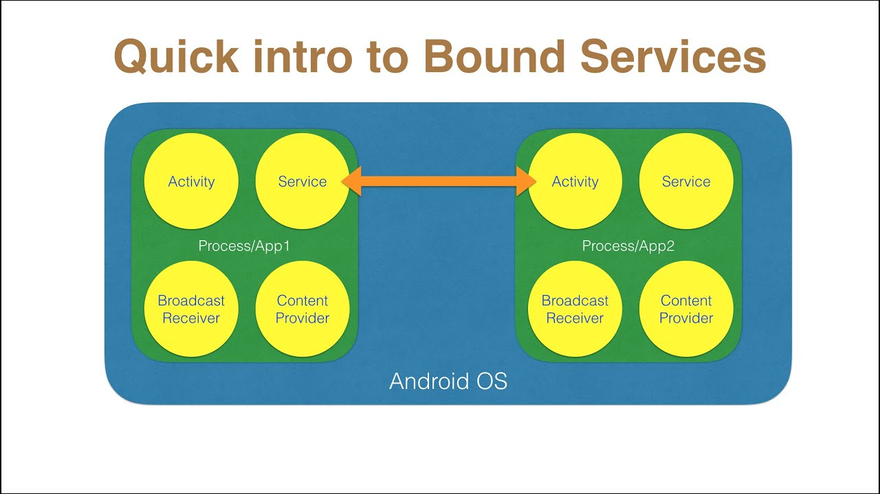
2. Bounded Service
It can be treated as a server in a client-server interface. By following this path, android application components can send requests to the service and can fetch results. A service is termed as bounded when an application component binds itself with a service by calling bindService() method. To stop the execution of this service, all the components must unbind themselves from the service by using unbindService() method.

Slide 10
Example
Step 1: Create a new project
Click on File, then New => New Project.
Choose Empty activity
Select language as Java/Kotlin
Select the minimum SDK as per your need.

Slide 11
Step 2: Modify strings.xml file
All the strings which are used in the activity are listed in this file.
<resources>
<string name="app_name">Services_In_Android</string>
<string name="heading">Services In Android</string>
<string name="startButtonText">Start the Service</string>
<string name="stopButtonText">Stop the Service</string>
</resources>

Slide 12
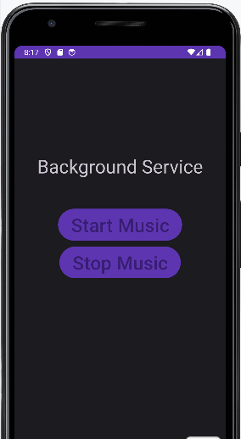
Step 3: Working with the activity_main.xml file
Open the activity_main.xml file and add 2 Buttons in it which will start and stop the service. Below is the code for designing a proper activity layout.

Slide 13
Step 4: Creating the custom service class
A custom service class will be created in the same directory where the MainActivity class resides and this class will extend the Service class. The callback methods are used to initiate and destroy the services. To play music, the MediaPlayer object is used. Below is the code to carry out this task.

Slide 14
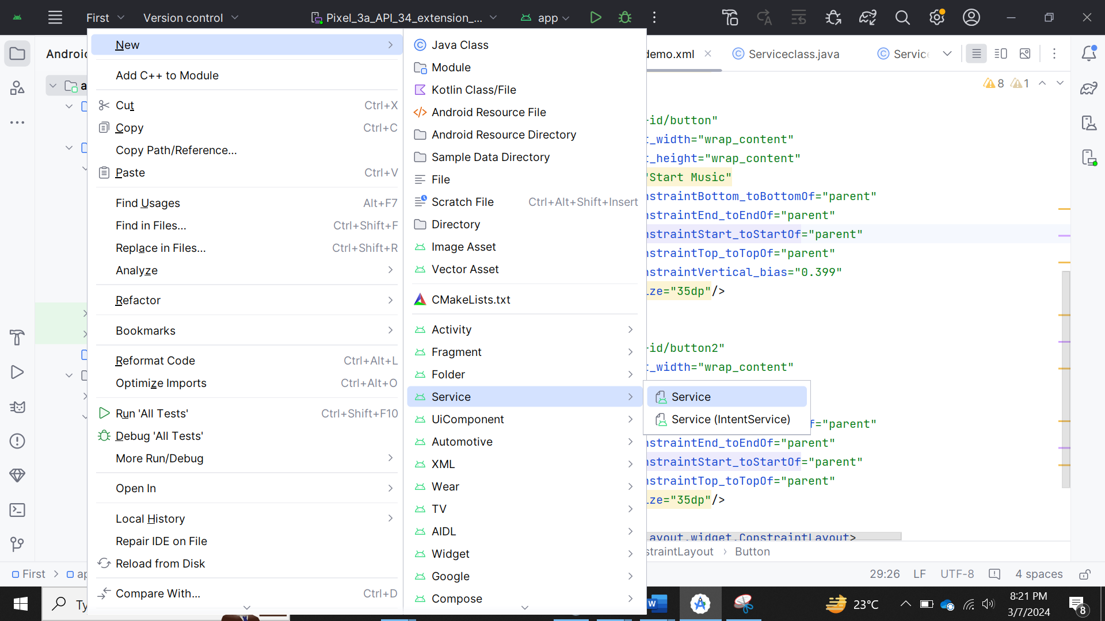

Slide 15
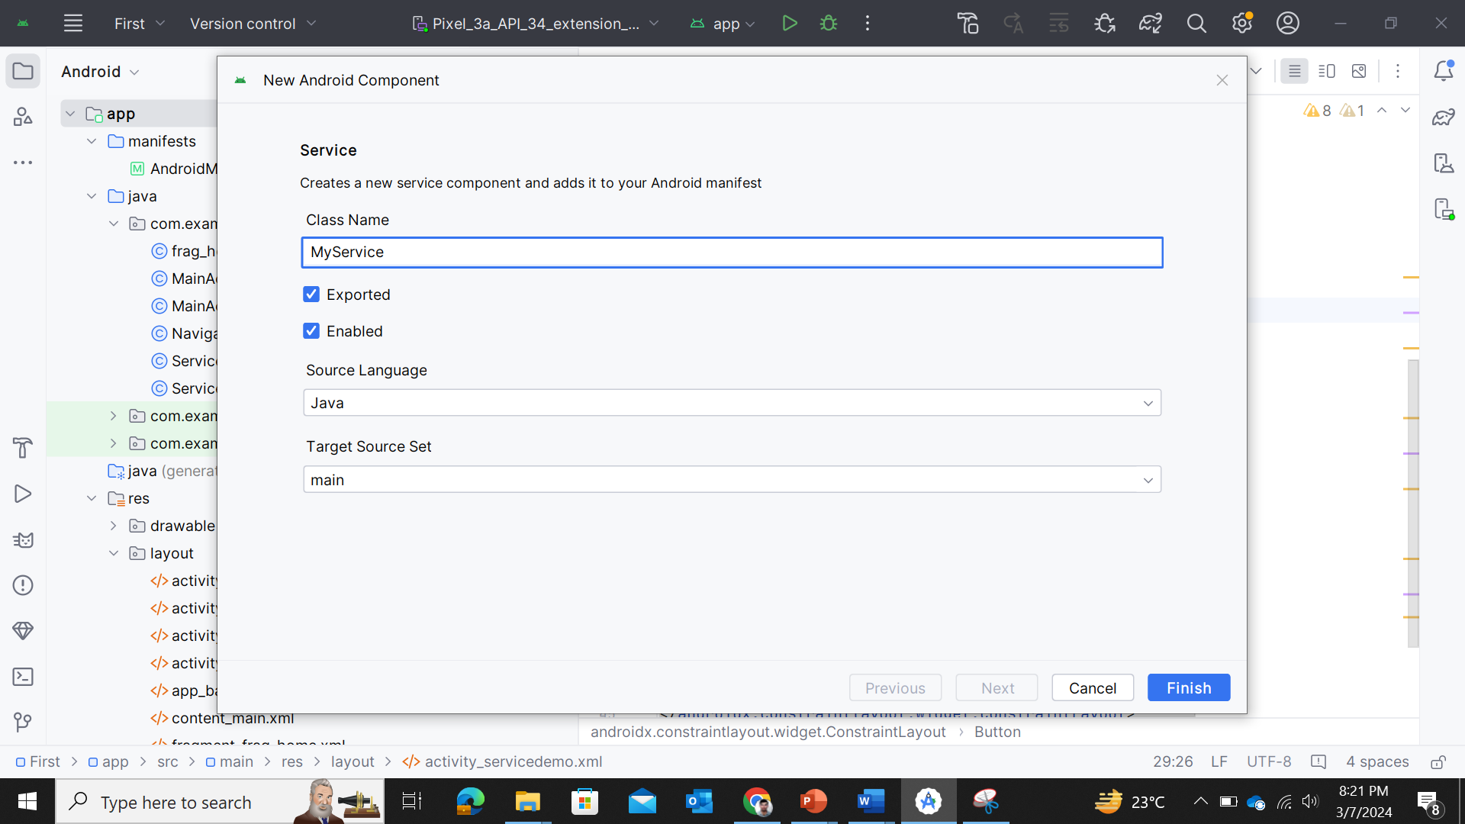

Slide 16
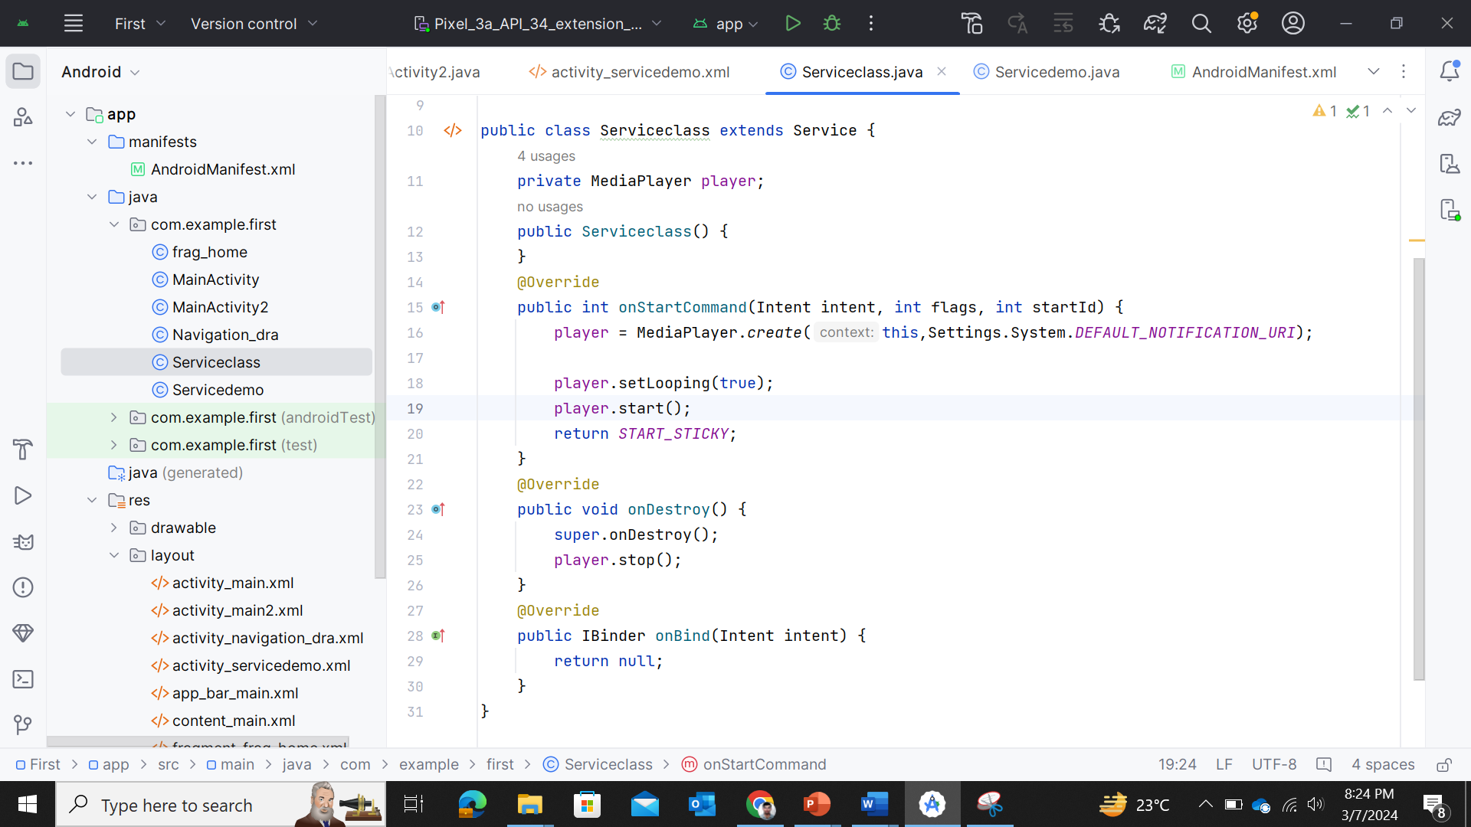

Slide 17
Step 5: Working with the MainActivity file
Now, the button objects will be declared and the process to be performed on clicking these buttons will be defined in the MainActivity class

Slide 18
